Slide 1
GEOG0125
Advanced Topics in Social and Geographic Data Science
spatial temporal MODELs & Bayesian updating
Dr Anwar Musah (a.musah@ucl.ac.uk)
Lecturer in Social and Geographic Data Science
UCL Geography
1

Slide 2
Contents
Problem
A quick recap of Week 8’s ICAR model
Data scenarios
Bayesian Updating for repeated cross-sectional datasets
Spatial Temporal Models for longitudinal datasets
What is Bayesian Updating:
Let’s explore an example: Mosquito infestation in Campina Grande, Brazil
Model framework in Stan
What are Spatial Temporal Models
Let’s explore an example: Fire-related casualties (2010—2019)
Model framework in Stan
Knowledge
Collect
Model
Wrangle
Explore
2

Slide 3
Quick recap on last week’s ICARs for spatial risk modelling
3

Slide 4
Besag-York-Mollie (BYM) (or CAR/ICAR models)
This is a popular spatial model which takes into account that the data may potentially be spatially correlated and the observations in the neighbouring areas may be more similar than observations in areas that are distant from each other.
This is a type of hierarchical model which includes a spatial random effect,
It is heavily dependent on the neighbourhood adjacency matrix
There are two versions of this model:
BYM model that has ONLY ‘fully specified’ spatial effect – Conditional Auto-Regressive model (CAR)
BYM model that has BOTH a spatial effect term which is treated a structured random effect, and the non-spatial effect term which is treated as an unstructured random effects – Intrinsic Conditional Auto-Regressive Model (ICAR). This is the best option.
When fitting data to this type of model – the best choice of the likelihood function (i.e., statistical model) is Poisson (i.e., aggregated counts to areas).
4
Notes:
Bayesian inference with a

Slide 5
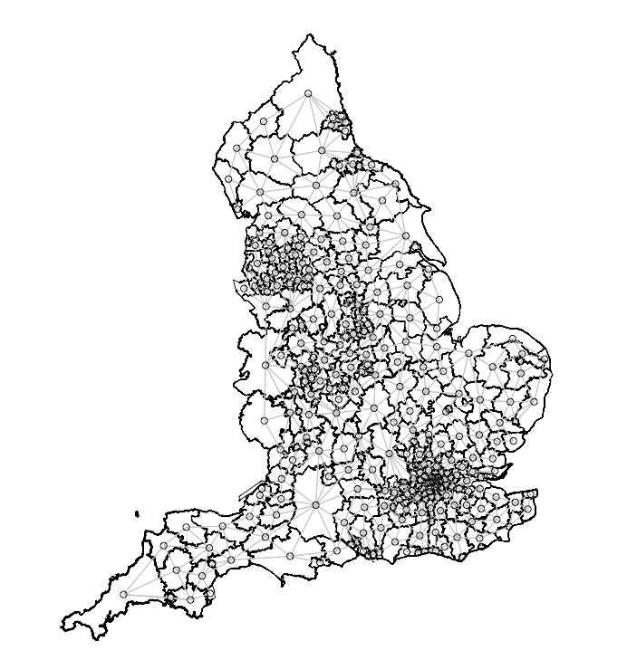
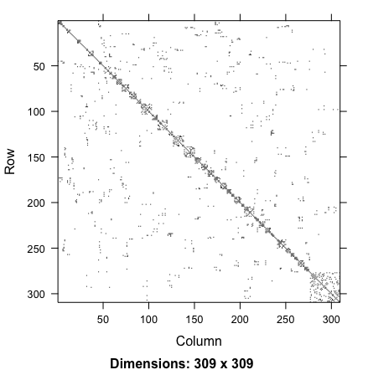
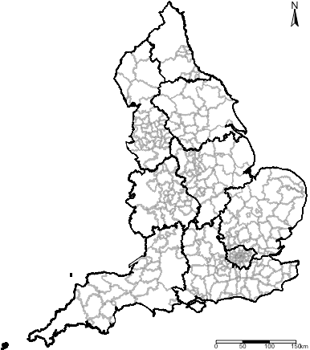
Geographically accurate
neighbourhood structure
Adjacency matrix translated to
graph format
Adjacency matrix translated to
nodes and edge format
Stan only uses the nodes and edges format to reconstruct the adjacency matrix (Queen contiguity-based).
5

Slide 6
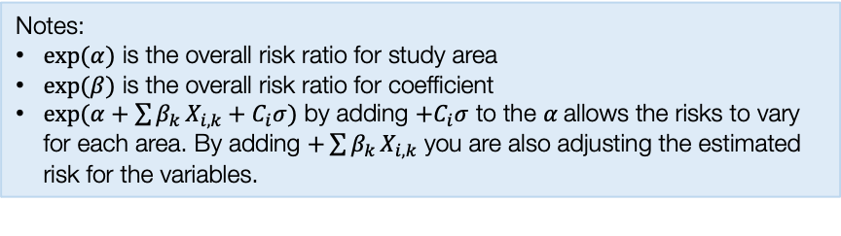
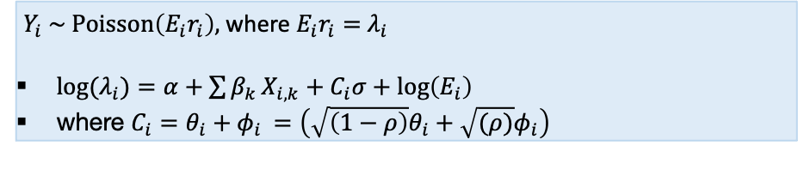
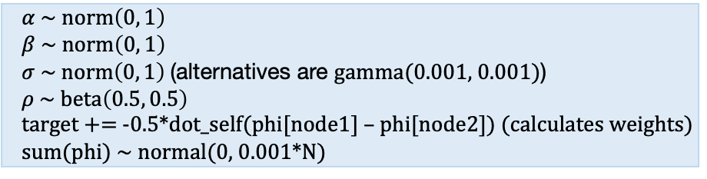
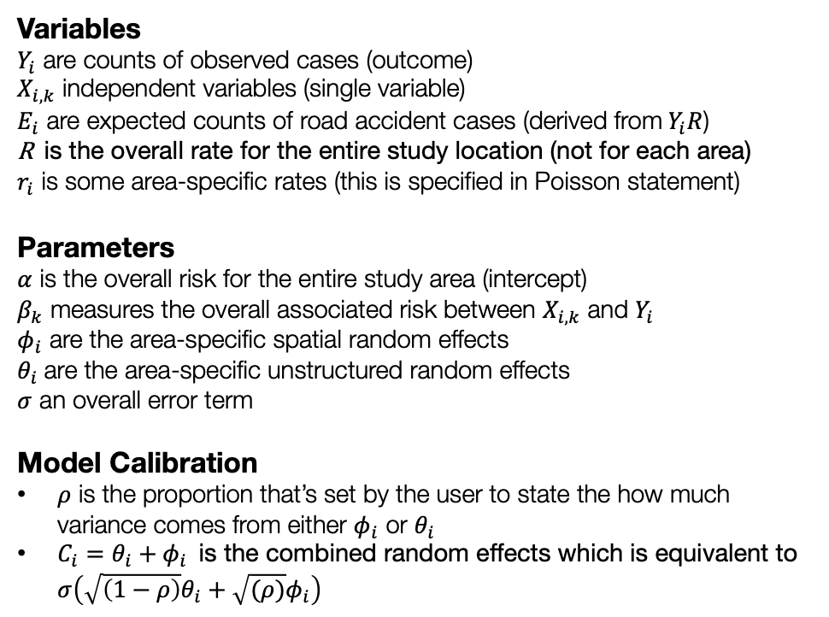
General model formulation for Spatial ICAR model
Model components
Full model specification
Variables
$Y_{i}$ are counts of observed cases (outcome)
$X_{i,k}$ independent variables (single variable)
$E_{i}$ are expected counts of road accident cases (derived from$Y_{i}R$)
R is the overall rate for the entire study location (not for each area)
$r_{i}$ is some area-specific rates (this is specified in Poisson statement)
Parameters
$α$ is the overall risk for the entire study area (intercept)
$β_{k}$ measures the overall associated risk between $X_{i,k}$ and $Y_{i}$
$φ_{i}$ are the area-specific spatial random effects
$θ_{i}$ are the area-specific unstructured random effects
$σ$ an overall error term
Model Calibration
$ρ$ is the proportion that’s set by the user to state the how much variance comes from either $φ_{i}$ or $θ_{i}$
$C_{i}=θ_{i}+φ_{i}$ is the combined random effects which is equivalent to $σ\left(\sqrt{\left(1−ρ\right)}θ_{i}+\sqrt{(ρ)}φ_{i}\right)$
Specify likelihood function. The outcome is often counts – thus it will be Poisson (with log as the link function).
$Y_{i} \sim Poisson\left(E_{i}r_{i}\right),$where $E_{i}r_{i}=$ $λ_{i}$
${log⁡(λ}_{i})=α+\sum{β_{k}}X_{i,k}+C_{i}σ+log\left(E_{i}\right)$
where $C_{i}=θ_{i}+φ_{i}$ $=\left(\sqrt{\left(1−ρ\right)}θ_{i}+\sqrt{(ρ)}φ_{i}\right)$
Define the priors for the intercept, coefficients and spatial and unstructured random effects as with an ICAR specification
$α \sim norm\left(0, 1\right)$
$β \sim norm\left(0, 1\right)$
$σ \sim norm\left(0, 1\right)$ (alternatives are gamma(0.001, 0.001))
$ρ \sim beta\left(0.5, 0.5\right)$
target += -0.5*dot_self(phi[node1] – phi[node2]) (calculates weights)
sum(phi) ~ normal(0, 0.001*N)
Build Bayesian model
Recall the Bayes’ Rule: $P\left(θ | Y\right)∝P\left(Y | θ\right)P(θ)$
Notes:
$exp⁡(α)$ is the overall risk ratio for study area
$exp⁡(β)$ is the overall risk ratio for coefficient
$exp(α+\sum{β_{k}}X_{i,k}+C_{i}σ)$ by adding ${+C}_{i}σ$ to the $α$allows the risks to vary for each area. By adding $+\sum{β_{k}}X_{i,k}$ you are also adjusting the estimated risk for the variables.
$$P\left(α, β_{k}, σ, φ_{i} | { λ}_{i}\right)∝P\left({ λ}_{i} | α, β_{k}, σ, φ_{i}\right) P\left(α\right)P\left(β_{k}\right)P\left(σ\right)P(φ_{i})P\left(ρ\right)$$
6

Slide 7
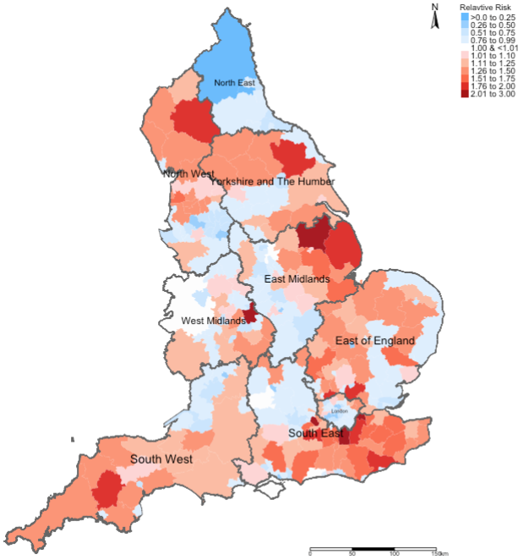
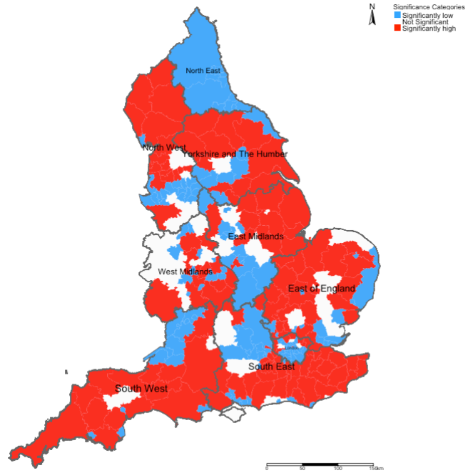
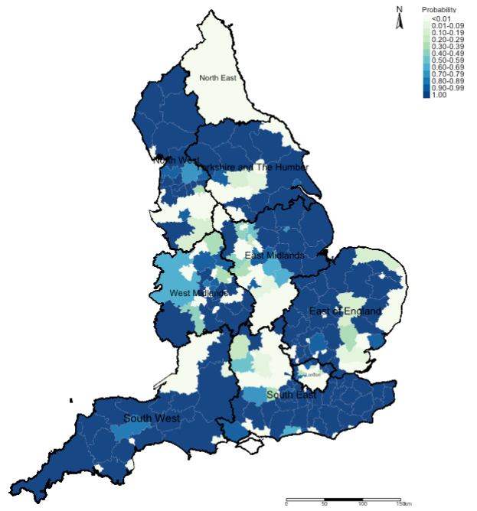
[1] Relative risk ratios (RR)
[2] Statistical Significance
[3] Exceedance Probabilities
Here, we use this output to describe the burden of an outcome
This output is to validate whether the risks described in output [1] are statistically significant or not
This output is used to describe the uncertainty that surrounds the risks which we found output [1]
7

Slide 8
Application using a cross-sectional framework
 | Survey Periods
LIRAa | 2013 | 2014 | 2015 | 2016 | 2017
1 | January | January | January | April | January
2 | March | March | March | July | April
3 | May | May | May | October | July
4 | July | July | October
5 | October | October
Using this snapshot time-period for April to demonstrate the application. This is a Cross-sectional framework
Methodology:
Population-based ecological study design within cross-sectional (and retrospective) framework
For covariates, the analysis included:
WorldClim (4.5km) (Maximum temperature and Precipitation) (monthly)
MOD18A1.061 Terra Vegetation Indices 16-Day Global 500m to compute neighbourhood levels of vegetation based on the NDVI metrics (monthly)
Worldpop.org (100m) to extract rasters for urbanisation (which contains binary grids) to compute the fraction of surface that is urbanised for neighbourhoods (yearly).
Spatial risk model with Intrinsic Conditional Autoregressive (ICAR) Model; and to derive new global coefficients for covariates for at that survey period for April 2017, as well as neighbourhood-specific relative risk estimates.
8
Notes:
In terms of methodology, we utilised

Slide 9
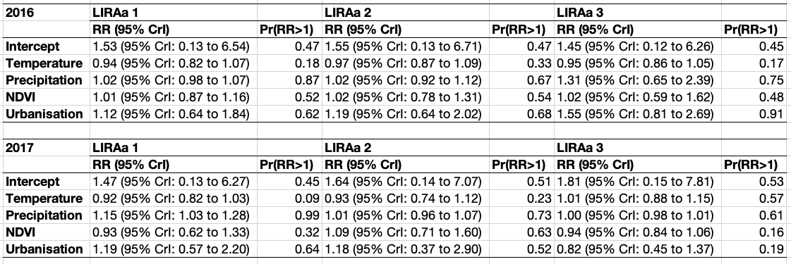
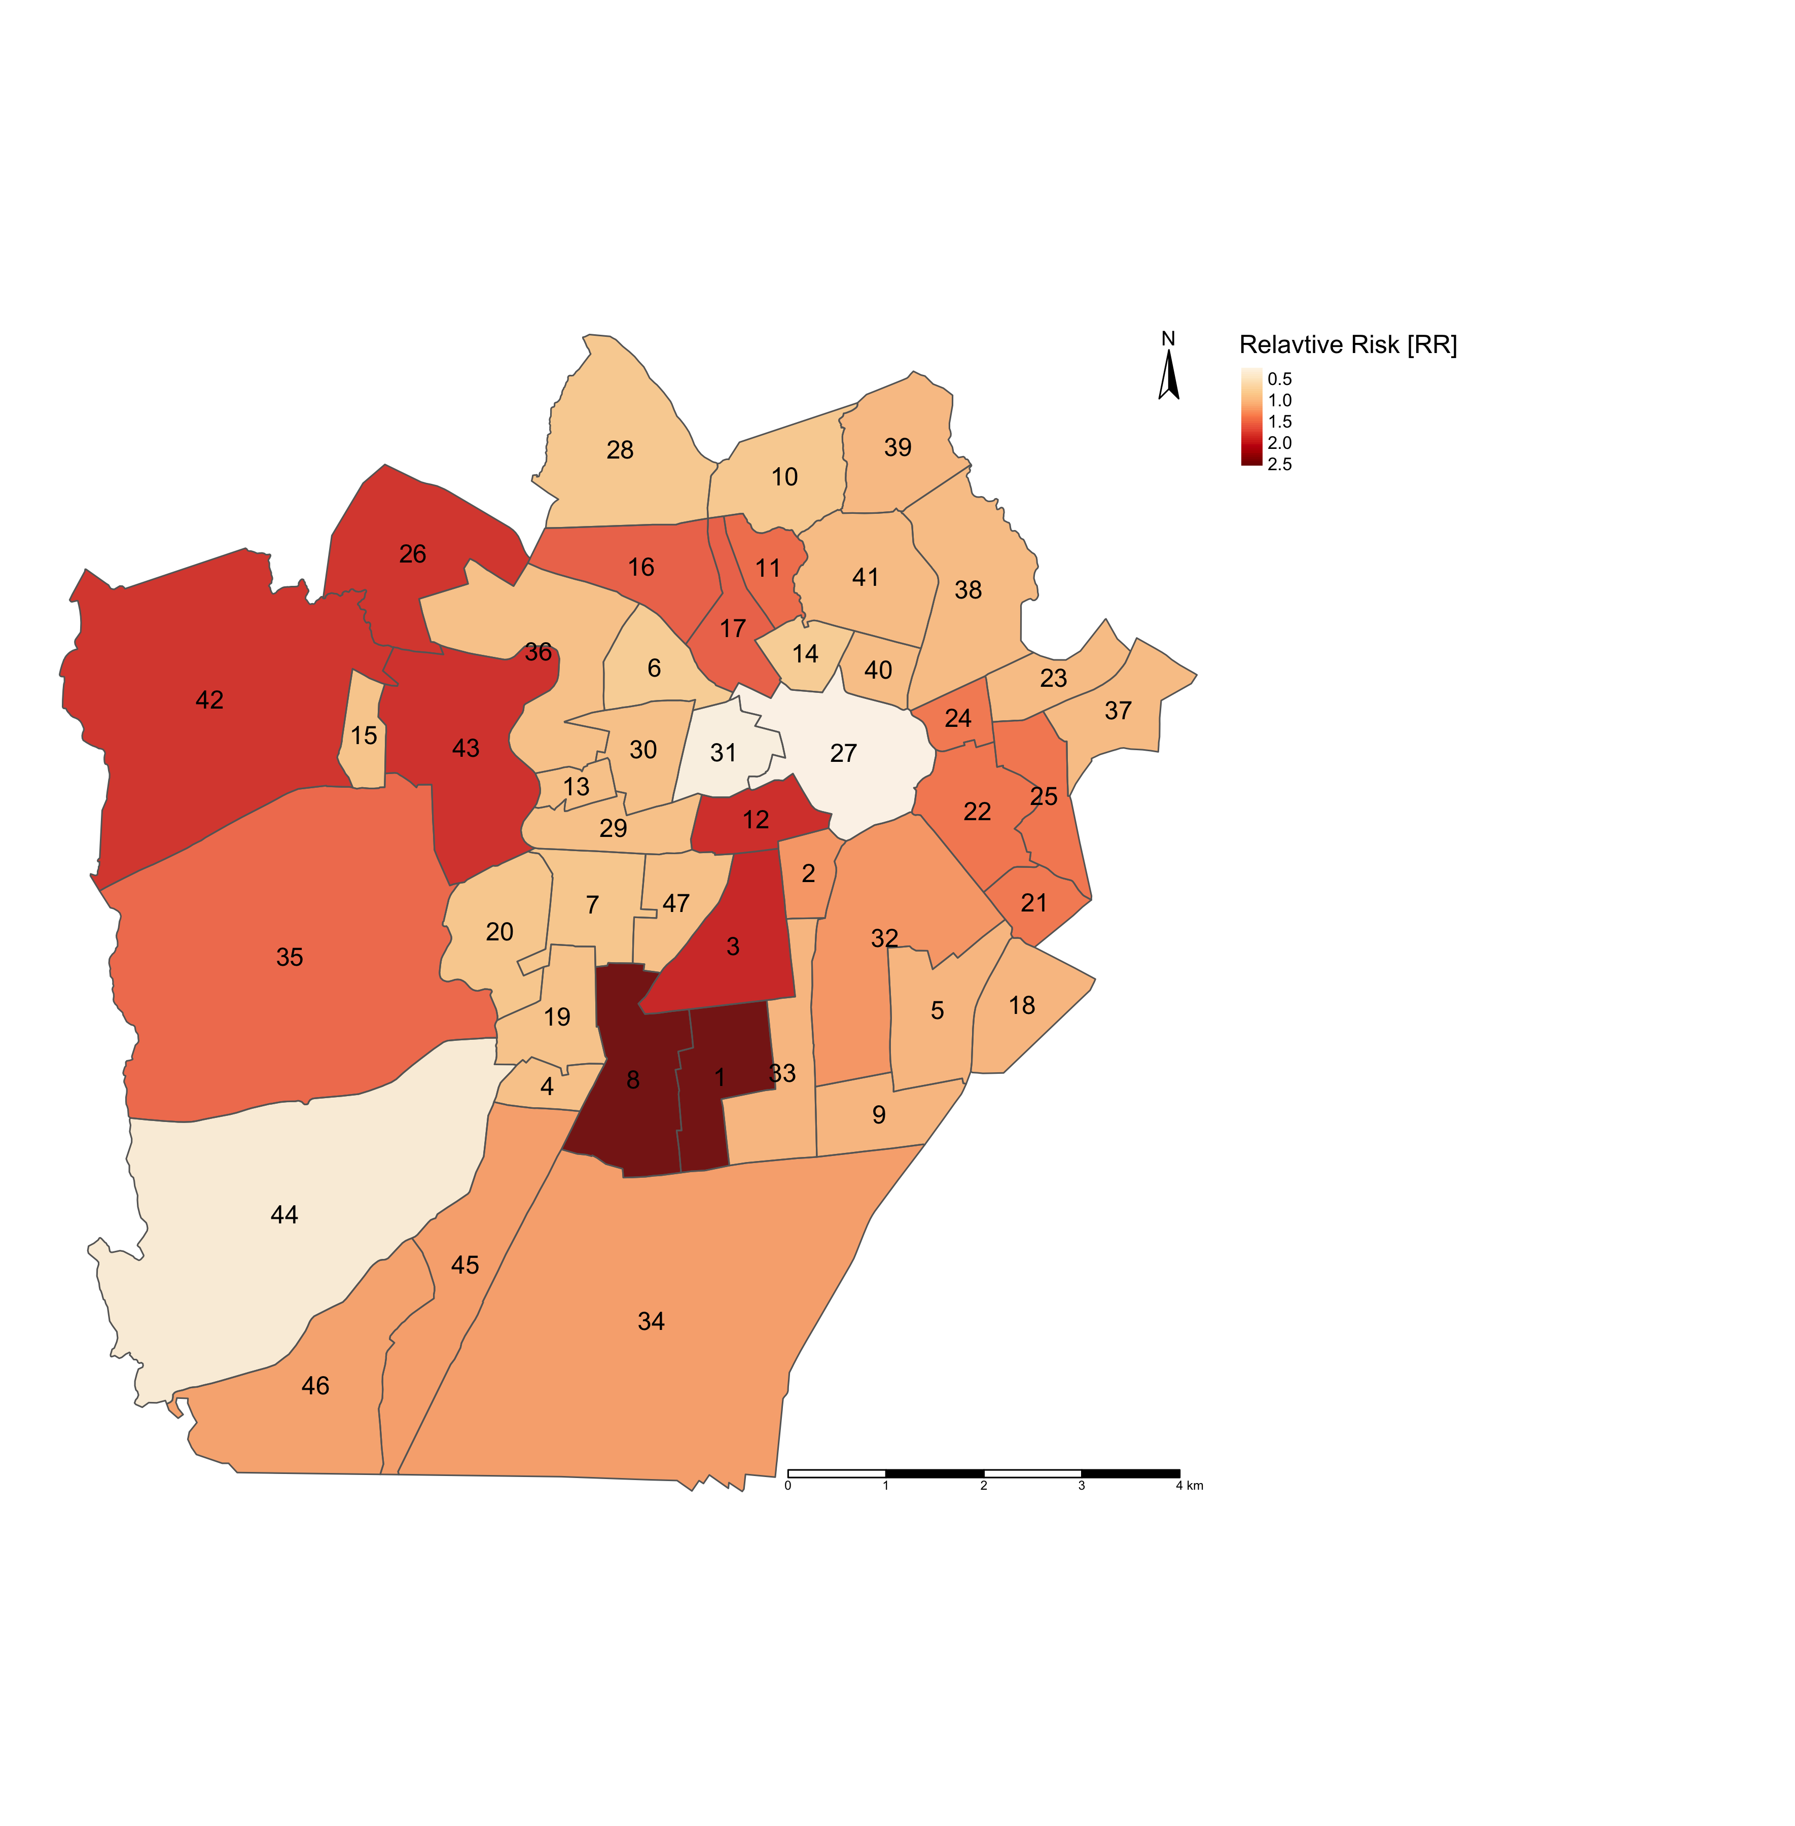
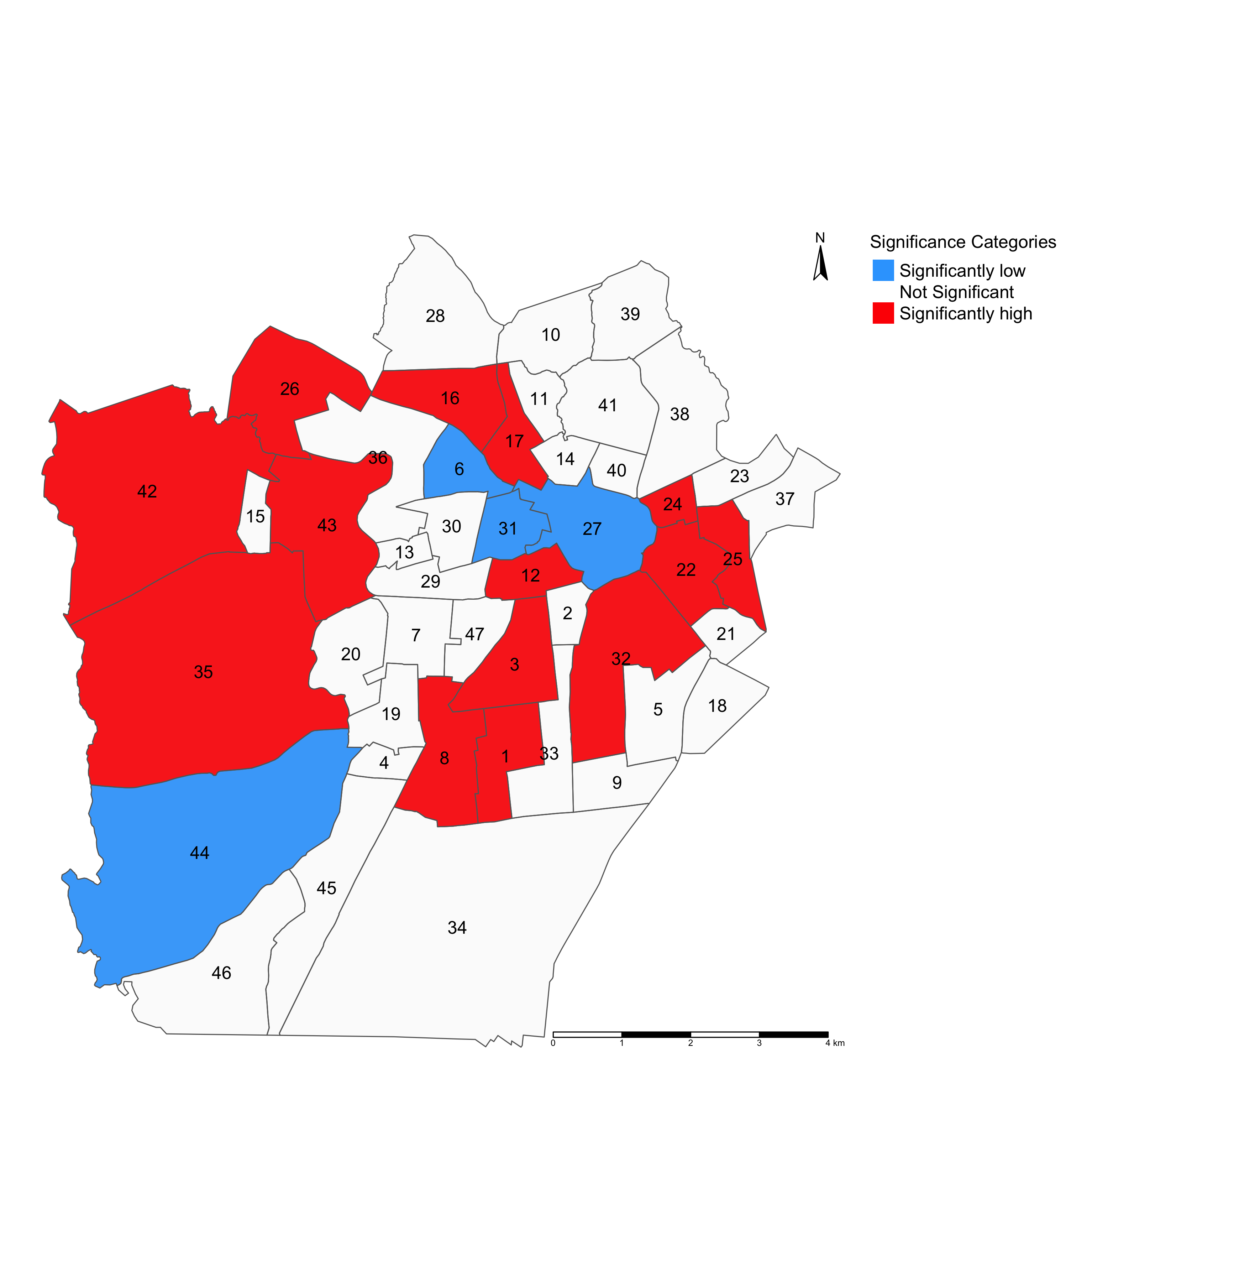
PART 1: Table results that illustrates the GLOBAL association between environmental, climate and anthropogenic factors and risk of infestation in Campina Grande (in LIRAa 2 survey period for April 2017) [Research framework is a cross-sectional study design].
Interpretation (examples):
Intercept: The overall risk of mosquito-borne infestation is 1.64 times (or 64%) higher in Campina Grande. The overall probability that there’s excess risk of infestation (i.e., RR > 1.00) is 51%.
Temperature: In relation to temperature, the risk of mosquito-borne infestation is 0.93 times (or 7%) lower in Campina Grande. The probability of observing an excess risk of infestation (i.e., RR > 1.00) in relation to temperature is 23%.
Urbanisation index: In relation to urbanisation, the risk of mosquito-borne infestation is 1.18 times (or 18%) higher in Campina Grande. The probability of observing an excess risk of infestation (i.e., RR > 1.00) in relation to urbanisation is 52%.
NOTE: All relative risk estimates have the null value (1) between its lower and upper 95% credibility intervals. While the results, excluding temperature, show an increased risk of infestation – these are all statistically not significant.
RR: Relative risks; Pr(RR > 1): Exceedance probabilities (the probability that RR being greater than 1)
PART 2: Maps on the left panel illustrates the relative risk (RR) of infestation across neighbourhoods in Campina Grande
PART 3: Maps on the right panel illustrates which neighbourhoods in Campina Grande have RRs that are significantly “low” or “high” risk
NOTE: There should be a map for
exceedance probabilities (this was not
shown)
LIRAa 2 2017
LIRAa 2 2017
Interpretation:
The following neighbourhoods in Campina Grande numbered 1, 3, 8 and 12 (for example) have RRs that are significantly above 1.00. These are examples of neighbourhoods containing households predicted to be at ‘high risk’ of being infested with mosquitoes. Neighbourhoods painted in RED need to be monitored for mosquito breeding hotspots to prevent further infestation, which, in turn, can lead to infectious disease outbreaks e.g., Zika or Dengue viruses!
RR < 1.00 (Low risk)
RR > 1.00 (High risk)
RR = 1.00 (Non-significant risk)
Continuous RR estimates
RR estimates categorised:
9

Slide 10
Scenarios
10

Slide 11
What if:
[1] The dataset are received in streams, or in a ‘repeated’ manner either on a regular or irregular interval
For example, we conduct this routine survey for mosquito infestation in Campina Grande, Brazil
 | Survey Periods
LIRAa | 2013 | 2014 | 2015 | 2016 | 2017
1 | January | January | January | April | January
2 | March | March | March | July | April
3 | May | May | May | October | July
4 | July | July | October
5 | October | October
Meaning that in each time point,
we try go to the same households in
each neighbourhood, and we keep
repeating these visits over, and
over again.
Note: While the surveys are routine,
do you notice how the survey periods
are conducted irregular? The study
design is ecological study design
known to be in a repeated
cross-sectional framework.
When you have a scenario, like this, it would be improper to analyse it as ‘true’ longitudinal or a spatial temporal fashion.
11

Slide 12
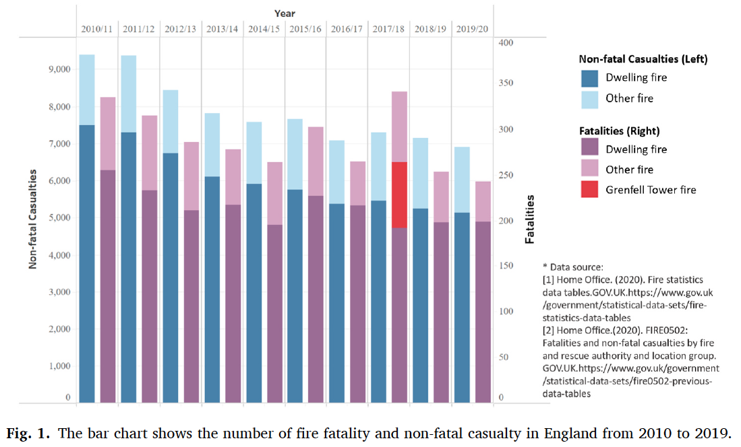
What if:
[2] The dataset are received in a full longitudinal format, where there is no lapses in the time frame i.e., the
intervals are ‘regular’
For example, annually report on surveillance information pertained to incident fire hazards across Fire Service
Areas (FSA) in England, UK
Meaning that in each time point, we document the number of fire-related hazards that occurred in
each FSA in a certain time point.
Note: The study design is also called an ecological study design known to be in a longitudinal framework.
When you have a scenario, like this, it would be proper to analyse it as ‘true’ longitudinal dataset
Li et al, (2022), Ecological study exploring the geospatial
associations between socioeconomic deprivation and
fire-related dwelling casualties in England (2010-2019),
DOI: https://doi.org/10.1016/j.apgeog.2022.102718
12

Slide 13
Scenarios
There are two approaches here:
[1]
[2]
Bayesian Model Updating
Spatial Temporal Models
13

Slide 14
Scenarios
[1]
[2]
Bayesian Model Updating
Spatial Temporal Models
The first scenario is the best approach for analysing data that’s received in streams on a ‘regular’ or ‘irregular’ basis. Suitable for use within a repeated cross-sectional analytical framework
14

Slide 15
Scenarios
[1]
[2]
Bayesian Model Updating
Spatial Temporal Models
The other scenario is the best approach for analysing data that’s received in longitudinal (which is often retrospective). It has no lapses in its interval. Suitable for use within a longitudinal analytical framework
15

Slide 16
Bayesian Updating
16

Slide 17
Bayesian Updating
Bayesian updating is a statistical method for revising the estimated probabilities about the events you’ve observed previously, and this revision is based on new evidence or information (data).
Bayesian updating technique is excellent choice for survey datasets that are generated routinely in a repeated cross-sectional fashion.
It is used for early warning modelling and off-the-fly predictions as soon as new data is received.
Bayesian updating needs to be executed in an iterative manner.
You have a baseline dataset, in which other subsequent data is applied to the Bayesian model for updating. Note that on the initial model with baseline information – you will need to specify the prior distribution for the parameters needed to be estimated. Afterwards, the model recalibrates itself by using the parameter estimates (i.e., posterior distribution) from the previous model run to set them as its new prior.
The updating will go through a process of a “learning curve” where you will see the estimated parameters evolve in the face of increasing new data.
17
Notes:
Bayesian inference with a

Slide 18
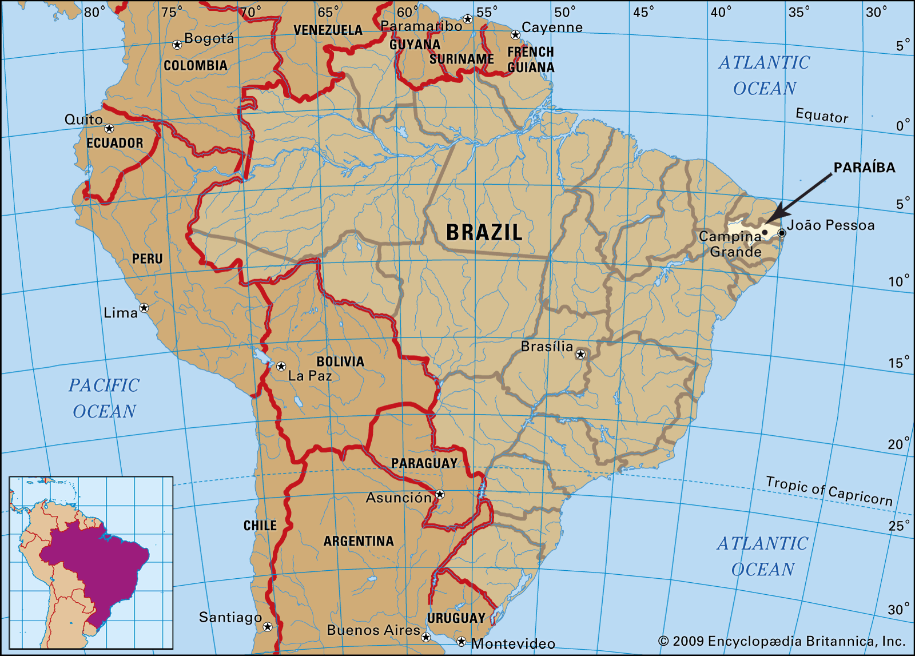
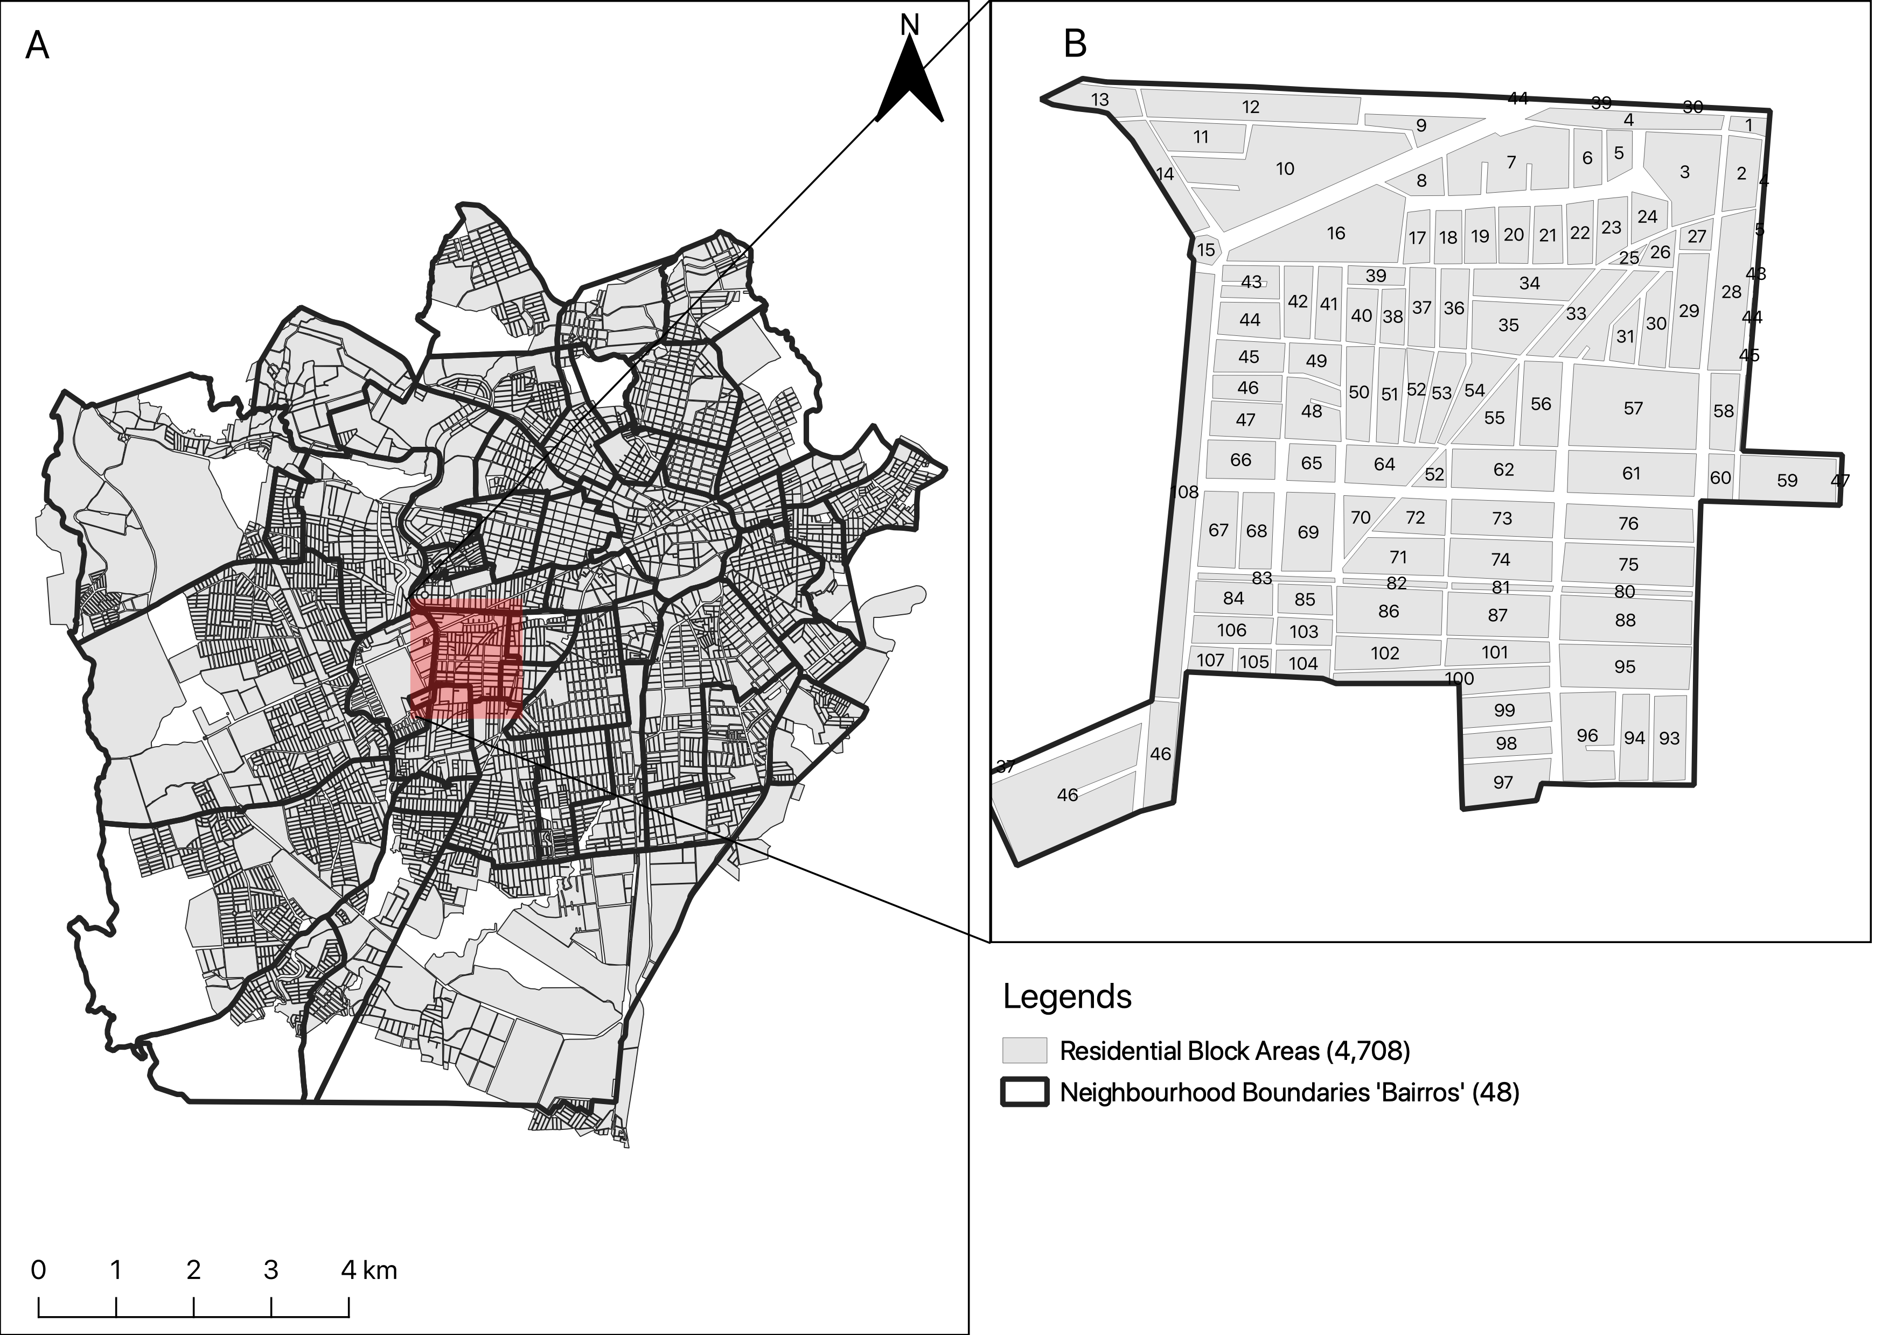
Campina Grande is into 47 neighbourhoods
Most recent vector control data (Levantamento Rapid de Indice para Aedes a [LIRAa]): January 2013 to October 2017 (performed 3–5 times in a year)
Baseline information – the overall number of houses in neighbourhood (as denominators); total number of households detected to be infested with larvae or adult mosquito (i.e., Aedes aegypti)
Aims and objectives:
To quantify the risk trajectories of mosquito infestation on a neighbourhood-level to informs the profile of the neighbourhood (i.e., whether the risks were sustained across the LIRAa periods).
Determining the set of environmental, climate and anthropogenic risk factors that impact neighbourhood-levels of Aedes aegypti infestation in households.
18
Notes:
Portuguese: Levantamento Rapido de Indice para Aedes aegypti (Rapid Index Survey for Aedes aegypti)

Slide 19
Research Methodology & Study design
 | Survey Periods
LIRAa | 2013 | 2014 | 2015 | 2016 | 2017
1 | January | January | January | April | January
2 | March | March | March | July | April
3 | May | May | May | October | July
4 | July | July | October
5 | October | October
Using these 6 snapshots demonstrate the application. This is a repeated cross-sectional framework
Methodology:
Population-based ecological study design within repeated cross-sectional (and retrospective) framework
For covariates, the analysis included:
WorldClim (4.5km) (Maximum temperature and Precipitation) (monthly)
MOD18A1.061 Terra Vegetation Indices 16-Day Global 500m to compute neighbourhood levels of vegetation based on the NDVI metrics (monthly)
Worldpop.org (100m) to extract rasters for urbanisation (which contains binary grids) to compute the fraction of surface that is urbanised for neighbourhoods (yearly).
Spatial risk model with Intrinsic Conditional Autoregressive (ICAR) Model; and applied Bayesian updating to derive new global coefficients for covariates for each LIRA survey, as well as neighbourhood-specific relative risk estimates.
19

Slide 20
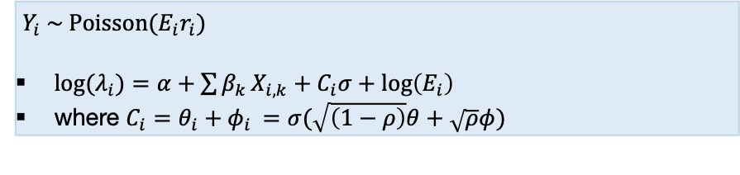
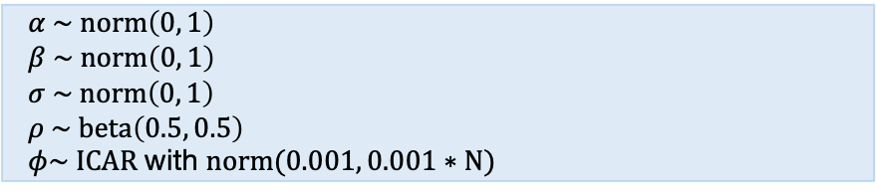
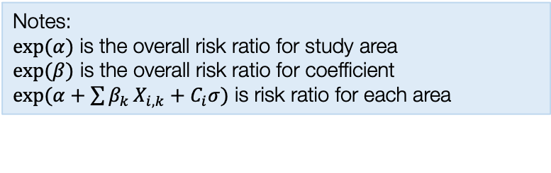
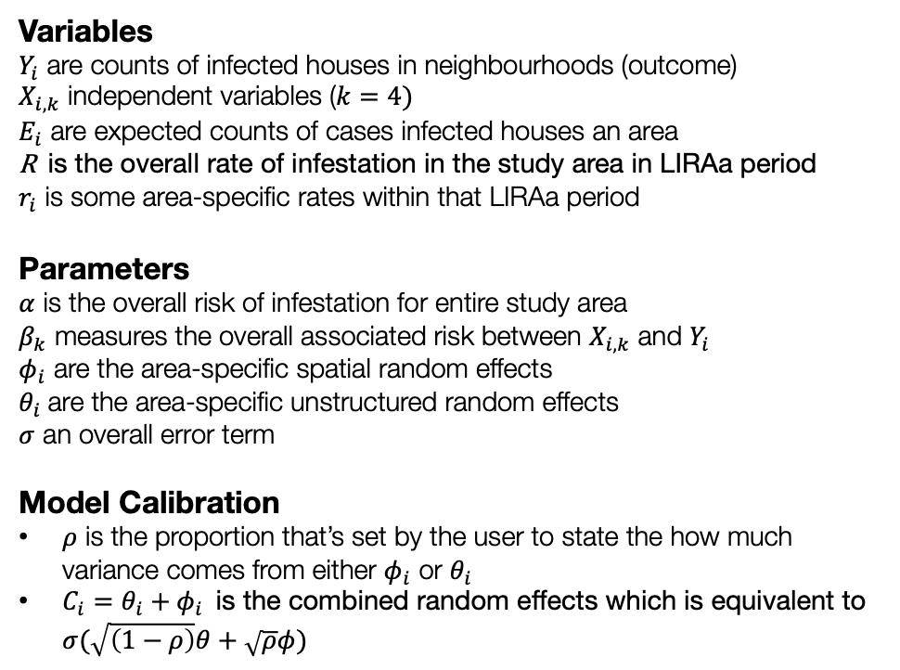
Model formulation for Spatial ICAR modelling and updating [1]
Model components
Full model specification
Variables
$Y_{i}$ are counts of infected houses in neighbourhoods (outcome)
$X_{i,k}$ independent variables ($k=4)$
$E_{i}$ are expected counts of cases infected houses an area
R is the overall rate of infestation in the study area in LIRAa period
$r_{i}$ is some area-specific rates within that LIRAa period
Parameters
$α$ is the overall risk of infestation for entire study area
$β_{k}$ measures the overall associated risk between $X_{i,k}$ and $Y_{i}$
$φ_{i}$ are the area-specific spatial random effects
$θ_{i}$ are the area-specific unstructured random effects
$σ$ an overall error term
Model Calibration
$ρ$ is the proportion that’s set by the user to state the how much variance comes from either $φ_{i}$ or $θ_{i}$
$C_{i}=θ_{i}+φ_{i}$ is the combined random effects which is equivalent to $σ(\sqrt{\left(1−ρ\right)}θ+\sqrt{ρ}φ)$
Specify likelihood function. The outcome often counts – thus it will be Poisson (with log as the link function).
$Y_{i} \sim Poisson(E_{i}r_{i})$
${log⁡(λ}_{i})=α+\sum{β_{k}}X_{i,k}+C_{i}σ+log\left(E_{i}\right)$
where $C_{i}=θ_{i}+φ_{i}$ $=σ(\sqrt{\left(1−ρ\right)}θ+\sqrt{ρ}φ)$
Define the priors for the intercept, coefficients and spatial and unstructured random effects as with an ICAR specification
$α \sim norm\left(0, 1\right)$
$β \sim norm\left(0, 1\right)$
$σ \sim norm\left(0, 1\right)$
$ρ \sim beta\left(0.5, 0.5\right)$
$φ\sim ICAR$ with $norm(0.001, 0.001∗N)$
Build Bayesian model
Recall the Bayes’ Rule: $P\left(θ | Y\right)∝P\left(Y | θ\right)P(θ)$
$$P\left(α, β_{k}, σ, φ_{i} | { λ}_{i}\right)∝P\left({ λ}_{i} | α, β_{k}, σ, φ_{i}\right) P\left(α\right)P\left(β_{k}\right)P\left(σ\right)P(φ_{i})P\left(ρ\right)$$
Notes:
$exp⁡(α)$ is the overall risk ratio for study area
$exp⁡(β)$ is the overall risk ratio for coefficient
$exp(α+\sum{β_{k}}X_{i,k}+C_{i}σ)$ is risk ratio for each area
New models with proceeding LIRAa data are used for updating the results. This is procedure is known as Bayesian updating.
We are breaking the data in chucks based on time points
20

Slide 21
Model formulation for Spatial ICAR modelling and updating [2]
[Step 1] Stan code
data {
int<lower=0> N;
int<lower=0> N_edges;
array[N_edges] int<lower=1, upper=N> node1;
array[N_edges] int<lower=1, upper=N> node2;
array[N] int<lower=0> Y;
vector<lower=1>[N] Offset;
int<lower=1> K;
matrix[N, K] X;
}
transformed data {
vector[N] log_Offset = log(Offset);
}
parameters {
real alpha; // intercept
vector[K] beta; // covariates
real<lower=0> sigma; // overall standard deviation
real<lower=0, upper=1> rho; // proportion unstructured vs. spatially structured variance
vector[N] theta; // unstructured random effects (heterogeneous)
vector[N] phi; // spatial random effects
}
transformed parameters {
vector[N] combined;
combined = sqrt(1 - rho) * theta + sqrt(rho) * phi;
}
model {
Y ~ poisson_log(log_Offset + alpha + X * beta + combined * sigma);
alpha ~ normal(0.0, 1.0); // prior for alpha: weakly informative
beta ~ normal(0.0, 1.0); // prior for betas: weakly informative
theta ~ normal(0.0, 1.0); // prior for theta: weakly informative
sigma ~ normal(0.0, 1.0); // prior for sigma: weakly informative
rho ~ beta(0.5, 0.5); // prior for rho: pulled for literature
target += -0.5 * dot_self(phi[node1] - phi[node2]);
sum(phi) ~ normal(0, 0.001 * N);
}
generated quantities {
vector[N] eta = alpha + X * beta + combined * sigma; // compute eta and exponentiate into mu
vector[N] rr_mu = exp(eta); // output the neighbourhood-specific relative risks in mu
vector[K] rr_beta = exp(beta); // output the risk ratios for each coefficient
real rr_alpha = exp(alpha); // output the risk ratios for the intercept
}
[Step 2] RStudio code
# Create that initial dataset
Lira2016_1 <- infestation_data[infestation_data$Year==2016 & infestation_data$LIRAa==1,]
y=Lira2016_1$InfestedNum
x=Lira2016_1[,c(11,12,13,15)]
e=Lira2016_1$Expected
stan.dataset.baseline <- list(N=n, N_edges=n_edges, node1=nod1, node2=nod2, Y=y, X=x, K=length(x), Offset=e)
Bayesian.model.baseline <- stan("Stan model file.stan", data=stan.dataset.baseline, iter=60000, chains=6, control = list(max_treedepth = 12), verbose = FALSE, seed = 72182605)
# extract the results for tables and map
Note: We use this code to run the model for the first time on the initial dataset to get our baseline results
21

Slide 22
Model formulation for Spatial ICAR modelling and updating [3]
[Step 3] RStudio code
# create the subsequent datasets for the updating
Lira2016_2 <- infestation_data[infestation_data$Year==2016 & infestation_data$LIRAa==2,]
Lira2016_3 <- infestation_data[infestation_data$Year==2016 & infestation_data$LIRAa==3,]
Lira2017_1 <- infestation_data[infestation_data$Year==2017 & infestation_data$LIRAa==1,]
Lira2017_2 <- infestation_data[infestation_data$Year==2017 & infestation_data$LIRAa==2,]
Lira2017_3 <- infestation_data[infestation_data$Year==2017 & infestation_data$LIRAa==3,]
# for Lira2016_2
y=Lira2016_2$InfestedNum
x=Lira2016_2[,c(11,12,13,15)]
e=Lira2016_2$Expected
stan.dataset.update1 <- list(N=n, N_edges=n_edges, node1=nod1, node2=nod2, Y=y, X=x, K=length(x), Offset=e)
# apply updating to next dataset based on posterior estimates from last model
Bayesian.model.update1 = stan(fit=Bayesian.model.baseline, data=stan.dataset.update1, iter=60000, chains=6, control = list(max_treedepth = 12), verbose = FALSE, seed = 72182605)
# extract the results for tables and map
### REPEAT
# for Lira2016_3
y=Lira2016_3$InfestedNum
x=Lira2016_3[,c(11,12,13,15)]
e=Lira2016_3$Expected
stan.dataset.update2 <- list(N=n, N_edges=n_edges, node1=nod1, node2=nod2, Y=y, X=x, K=length(x), Offset=e)
# again, apply updating to next dataset based on posterior estimates from last model
Bayesian.model.update2 = stan(fit=Bayesian.model.update1, data=stan.dataset.update2, iter=60000, chains=6, control = list(max_treedepth = 12), verbose = FALSE, seed = 72182605)
# extract the results for tables and map
### RINSE AND REPEAT UNTIL ALL DATASETS ARE COMPLETED
Note 1: We use this code to dataset that proceeds after the initial (Baseline) dataset. These are dataset which contain the new information once we keep repeating the survey over, and over again.
Note 2: We take the model fit from previous model (baseline model) and use the parameters to calibrate as priors and use the new wave of data to update the results for the first time.
Note 3: We take the model fit from previous model (1st updated model) and use its parameters to calibrate as priors again, and use the new wave of data to update the results a second time – we rinse and repeat…
22

Slide 23
Table results illustrates the overall association between environmental, climate and anthropogenic factors and risk of infestation in Campina Grande.
Baseline
Updated from 2016’s LIRAa 1
Updated from 2016’s LIRAa 1 & 2
Updated from 2016’s LIRAa 1, 2 & 3, and 2017’s LIRAa 1
Updated from 2016’s LIRAa 1, 2 & 3, and 2017’s LIRAa 1 and 2
Updated from 2016’s LIRAa 1, 2 & 3
RR: Relative risks
Pr(RR > 1): Exceedance probabilities (the probability that RR being greater than 1)
23

Slide 24
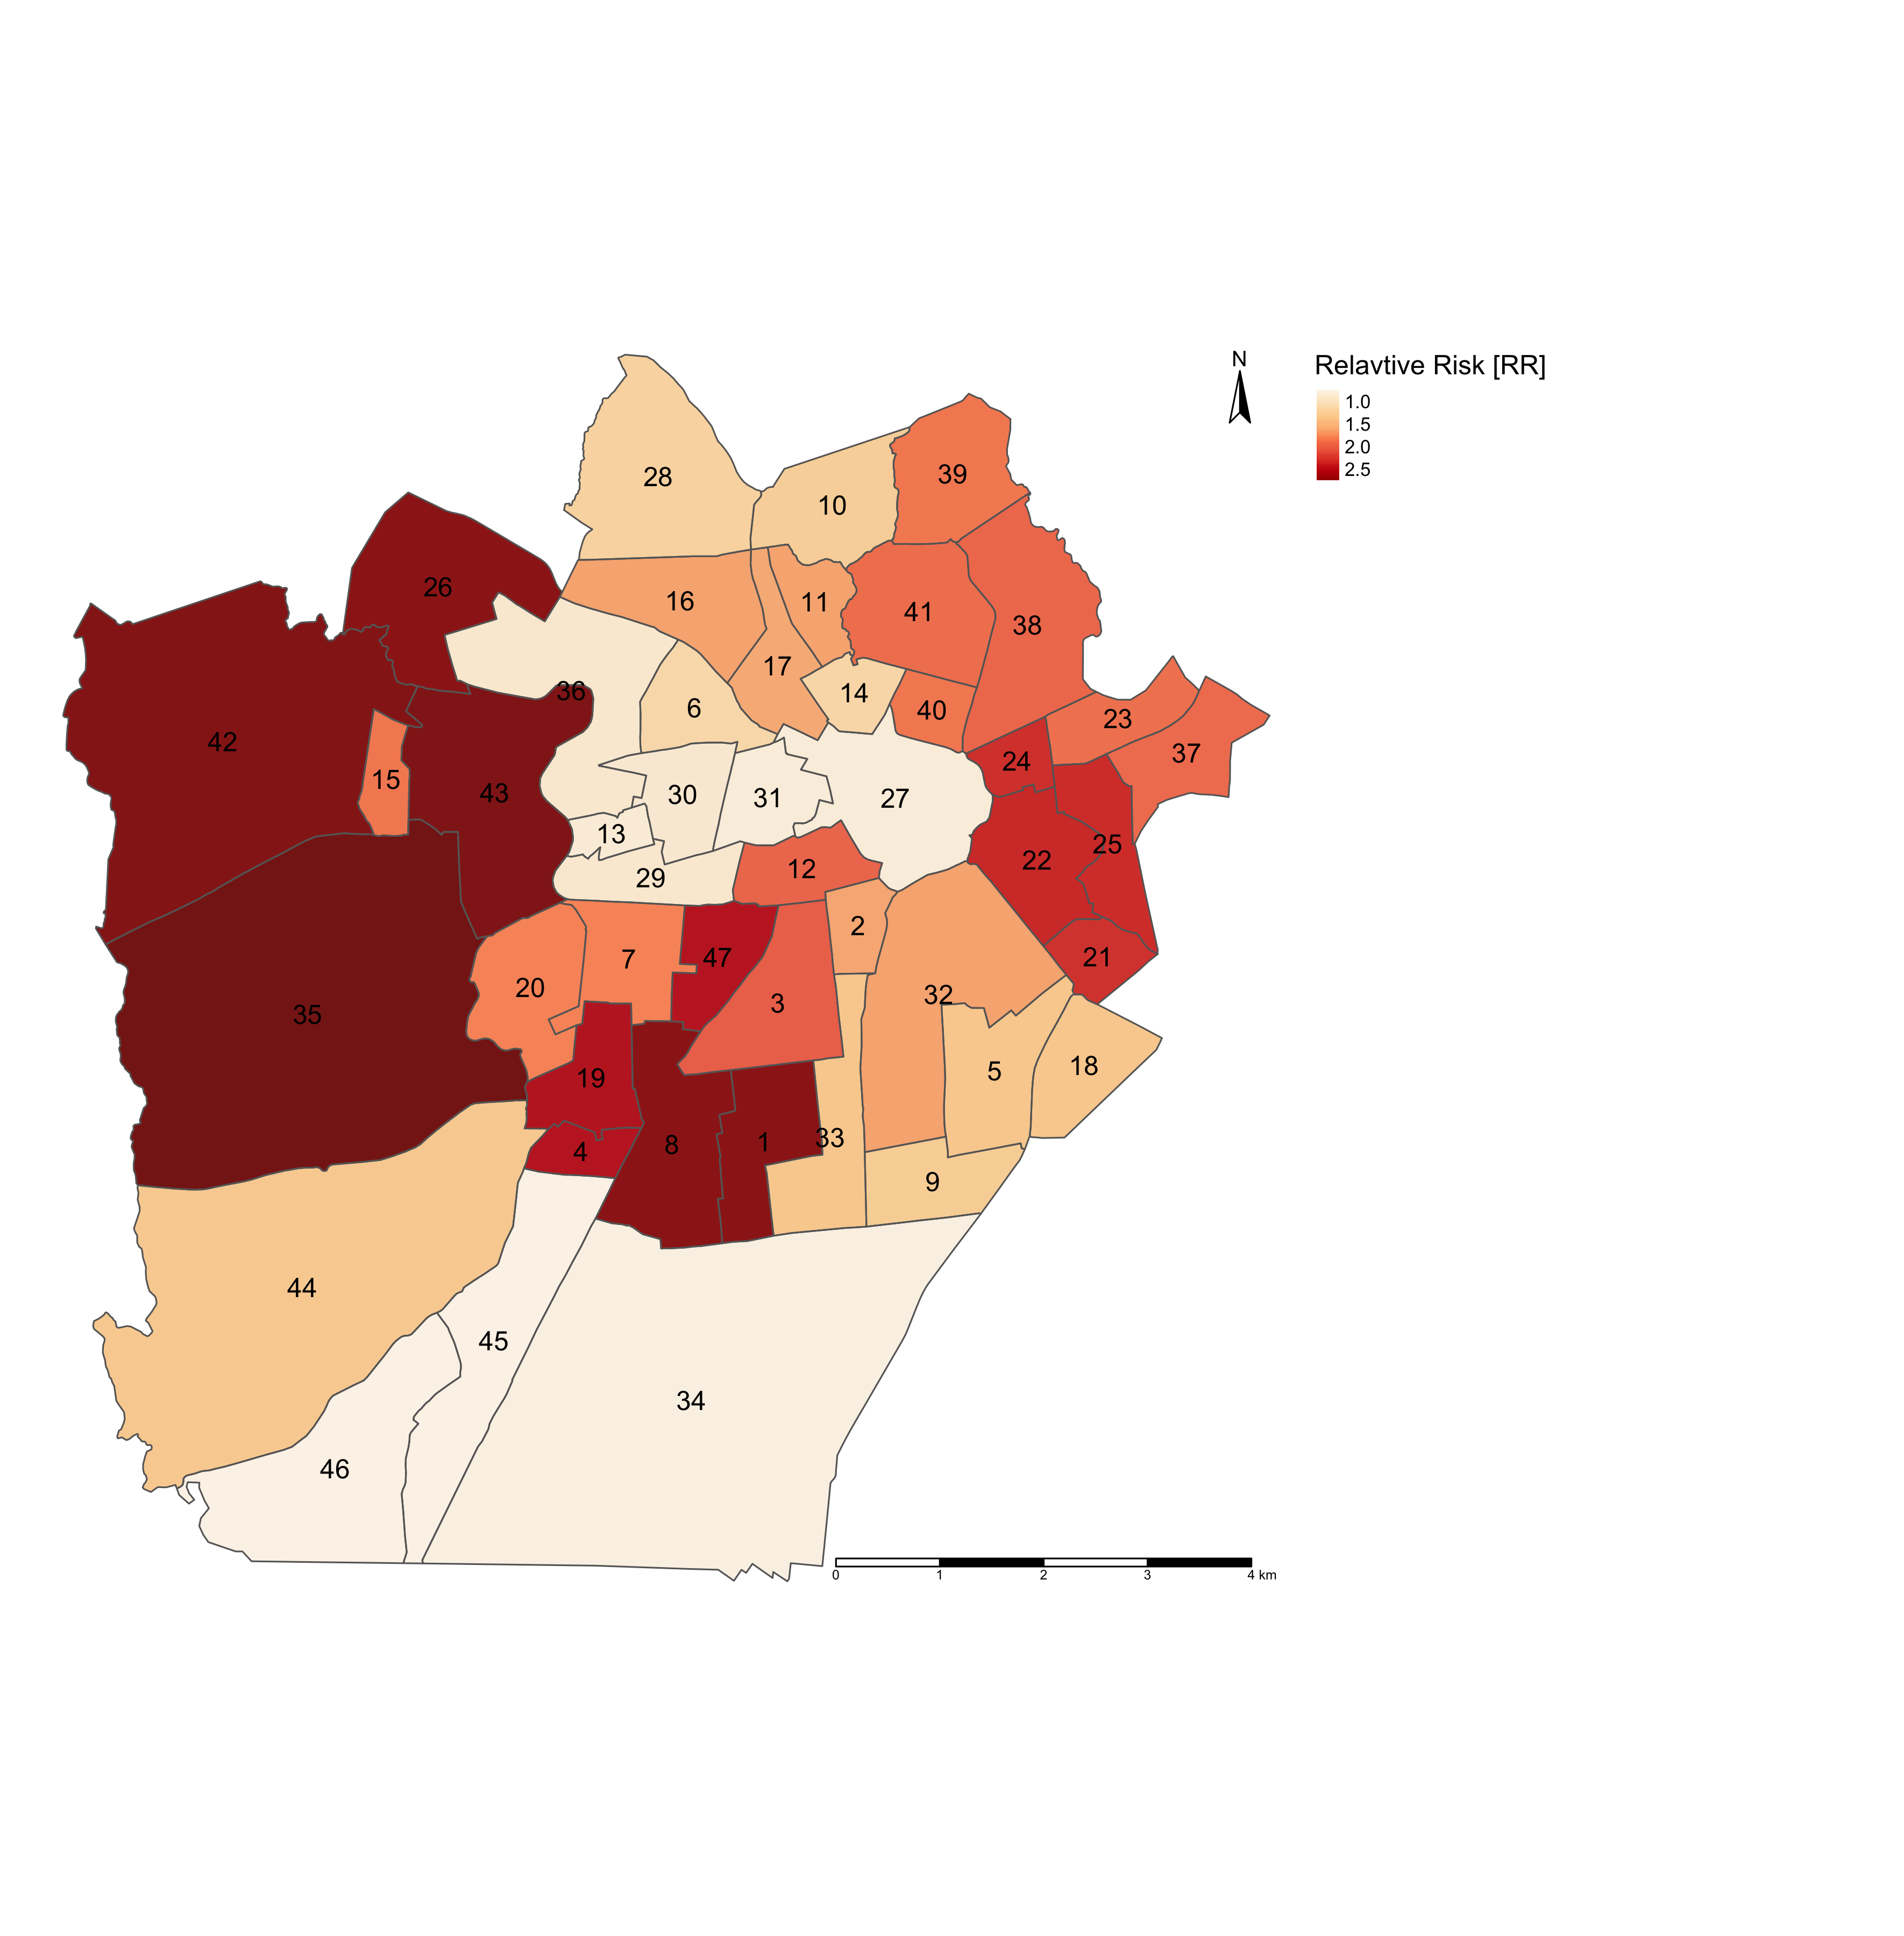
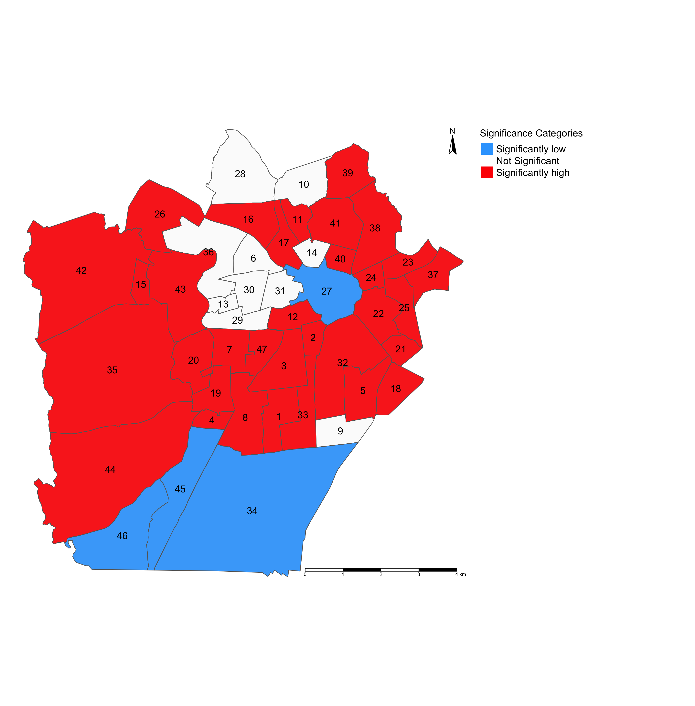
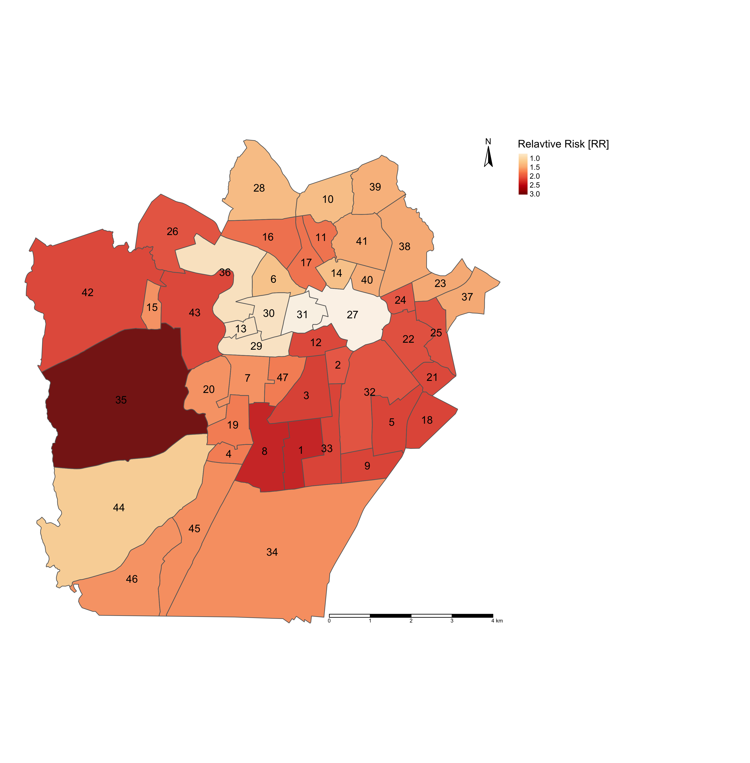
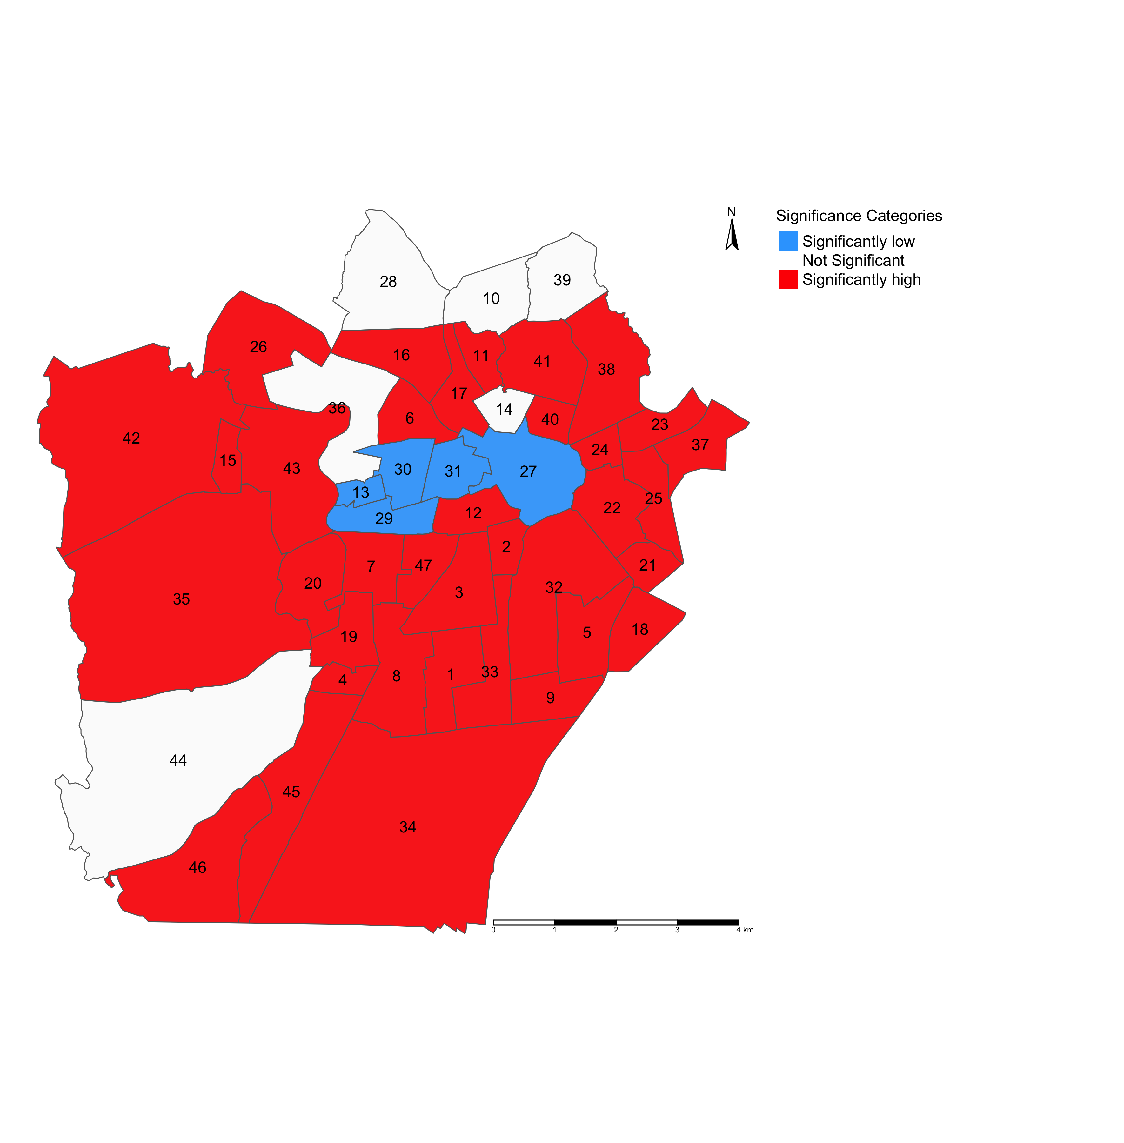
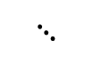
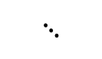
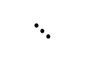
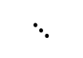
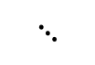
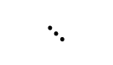
Maps on the left panel illustrates the relative risk (RR) of infestation across neighbourhoods in Campina Grande
Maps on the right panel illustrates which neighbourhoods in Campina Grande have RRs that are significantly “low” or “high” risk
$$⋱$$
$$⋱$$
$$⋱$$
$$⋱$$
LIRAa 1 2017
LIRAa 1 2017
LIRAa 2 2017
LIRAa 2 2017
LIRAa 3 2017
LIRAa 3 2017
$$⋱$$
$$⋱$$
RR < 1.00 (Low risk)
RR > 1.00 (High risk)
RR = 1.00 (Non-significant risk)
24

Slide 25
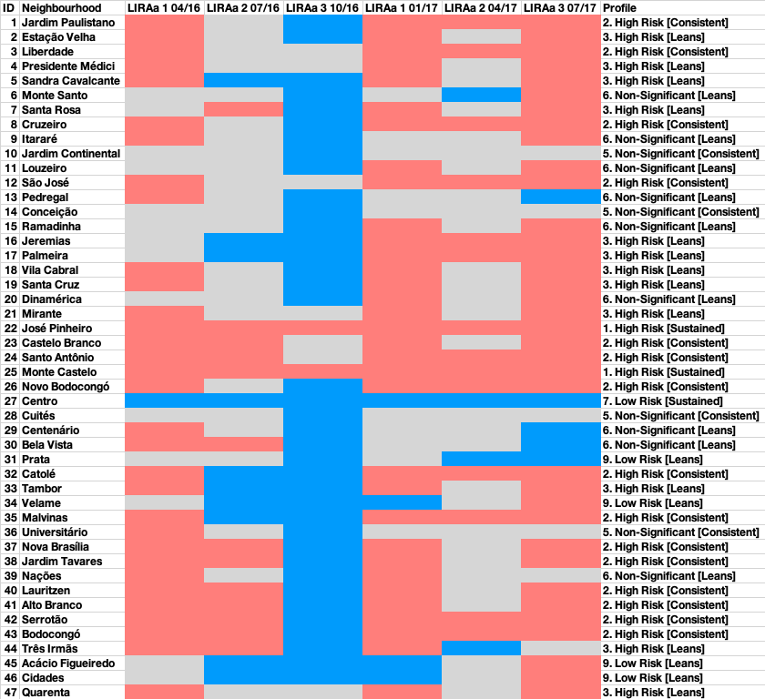
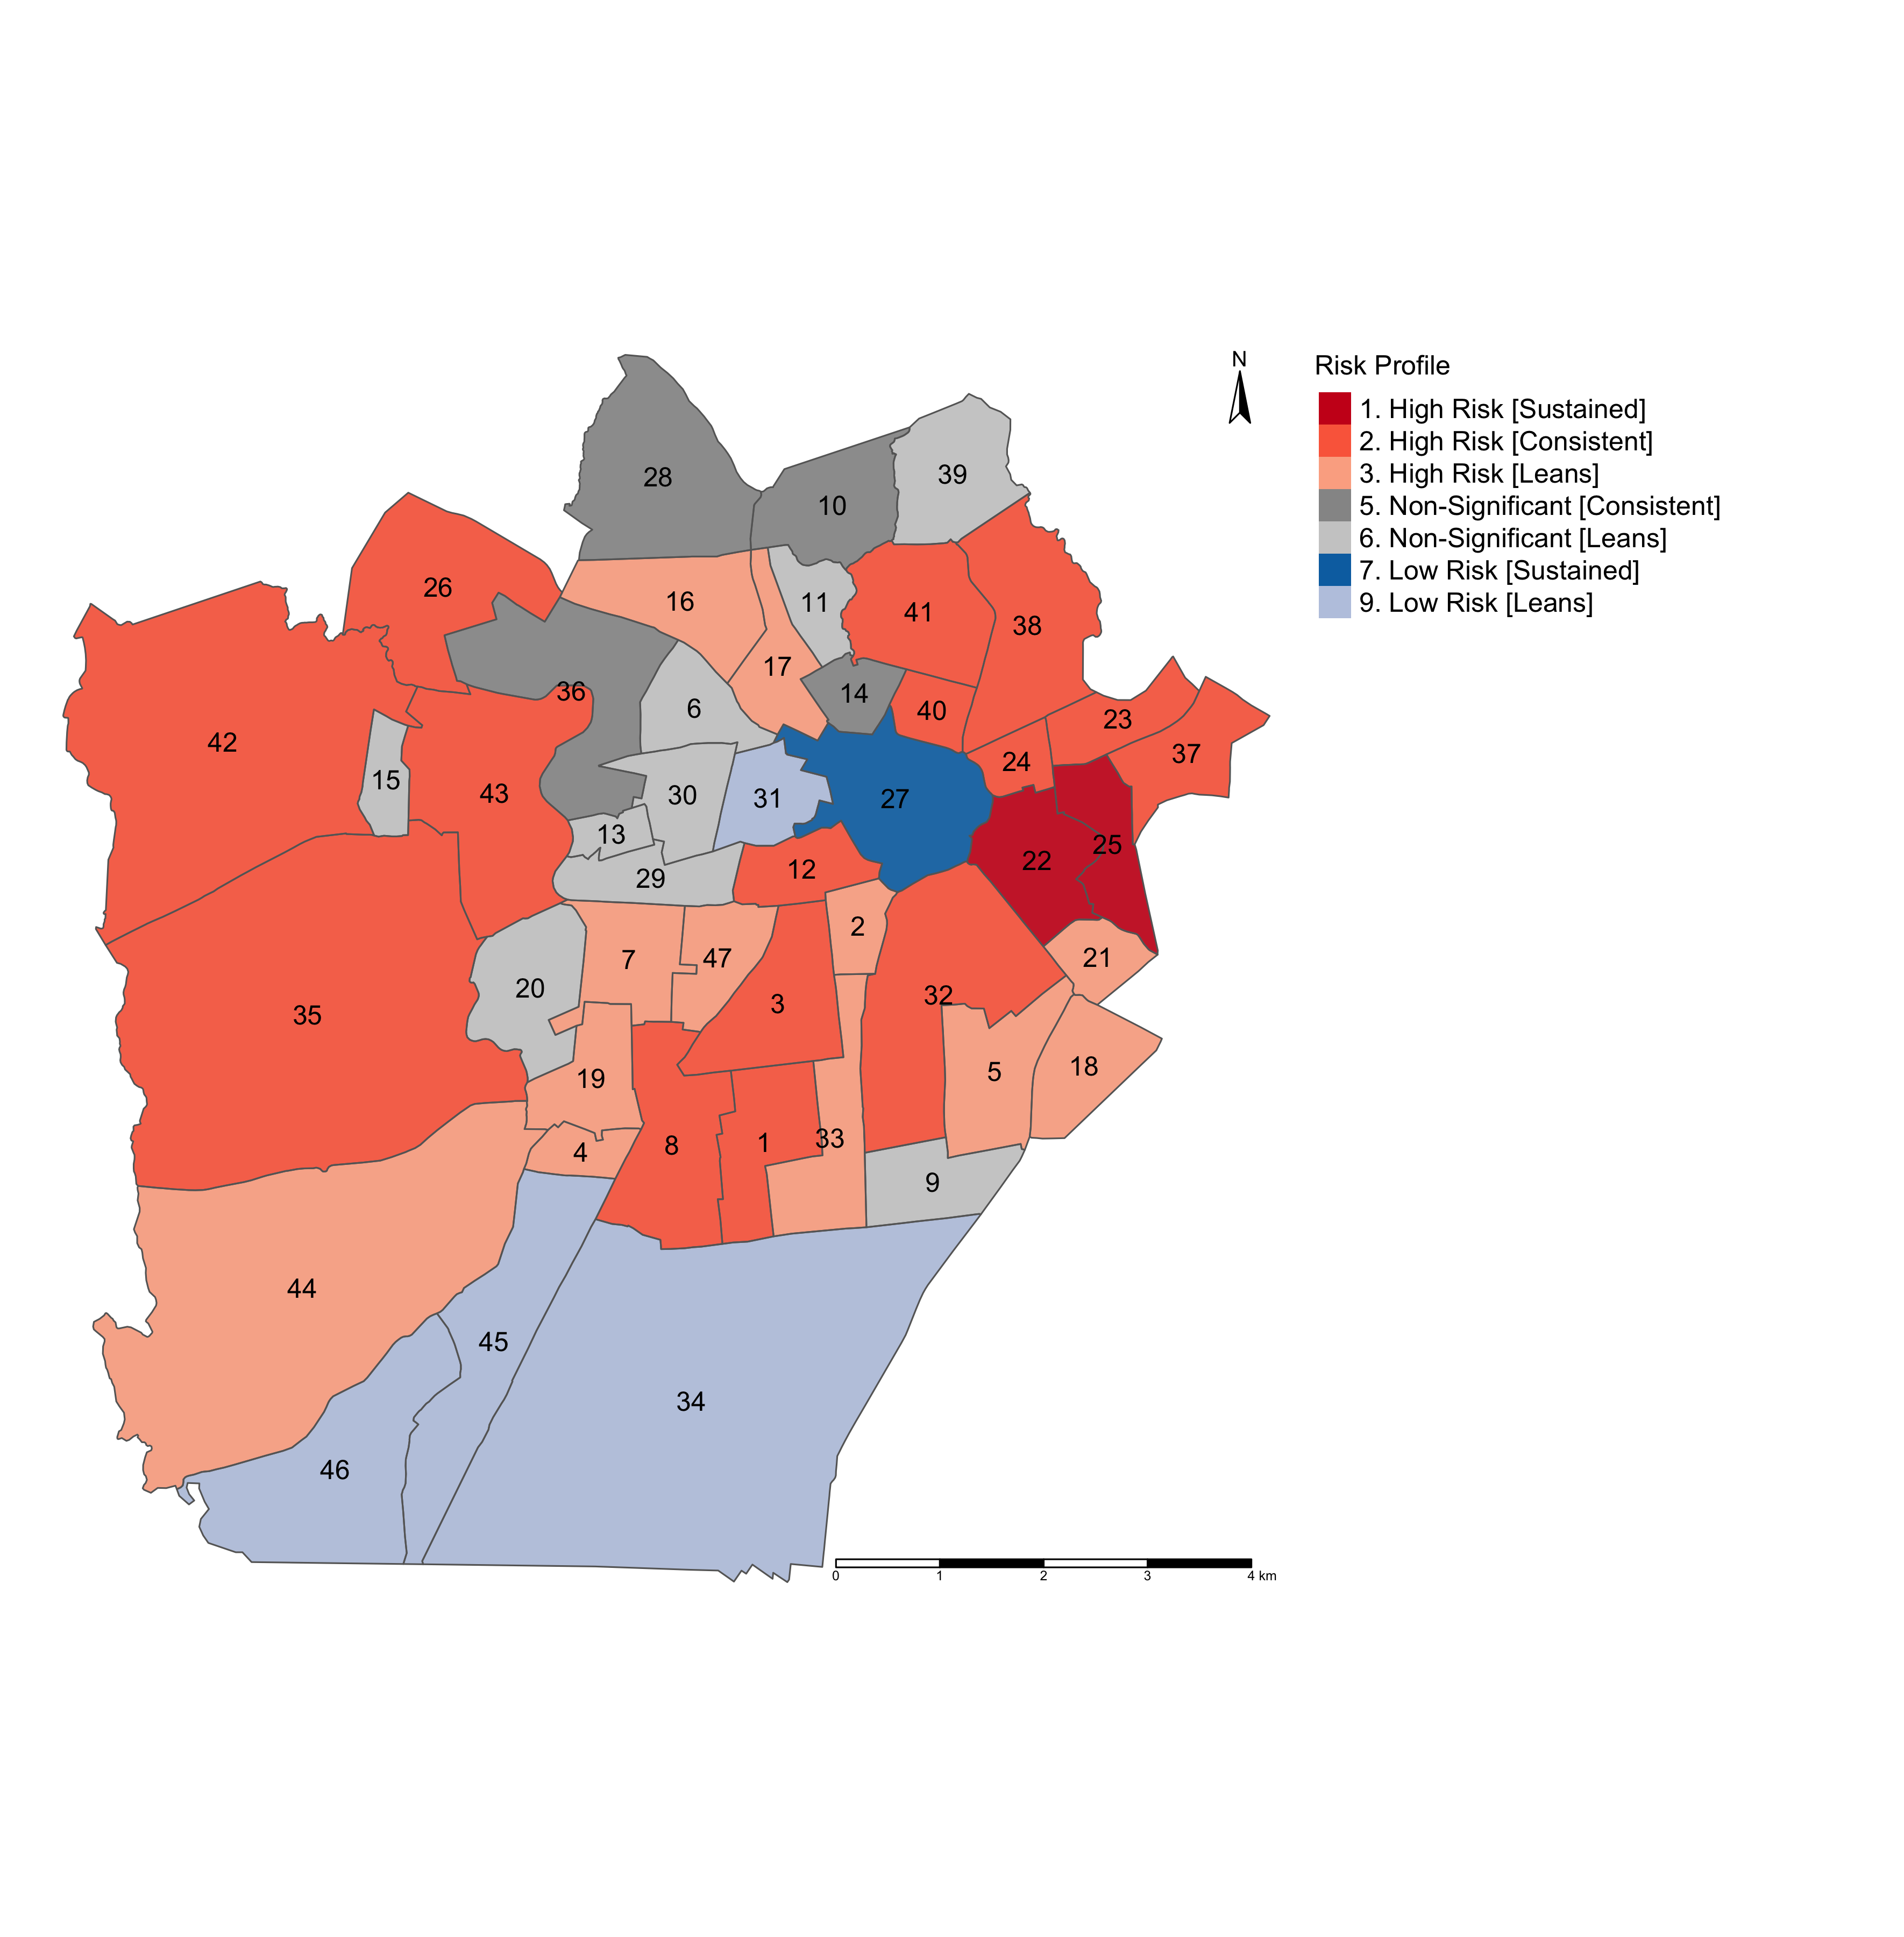
Modelling the risk trajectories and charting them across these LIRAa periods
Profiling the neighbourhoods accordingly to examine where these significant risks of infestation are sustained
I will show you how to pull this off in the practicals!
25

Slide 26
Spatial Temporal Models
26

Slide 27
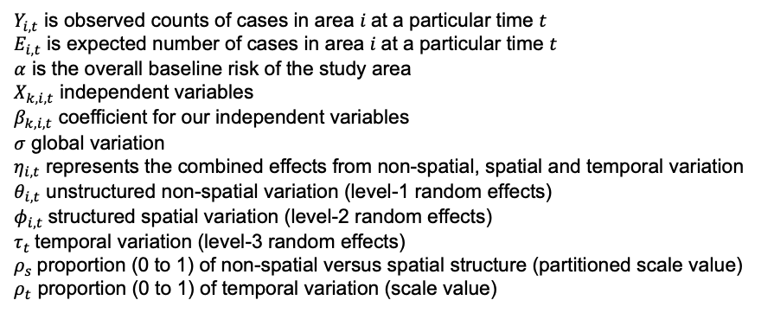
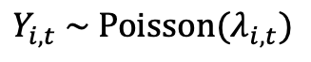
307 areal units (i) followed over with
information (t) times
But this adjacency matrix for the Local Authorities remain fixed
Model formulation will
remain the same ICAR
model, but we extend it
into a 3-level hierarchical
structure with the inclusion of time as a random effect
Stan only uses the nodes and edges format to reconstruct the adjacency matrix (Queen contiguity-based).
Model formulation
Model components
$$Y_{i,t} \sim Poisson(λ_{i,t})$$
$Y_{i,t}$ is observed counts of cases in area $i$at a particular time $t$
$E_{i,t}$ is expected number of cases in area $i$at a particular time $t$
$α$ is the overall baseline risk of the study area
$X_{k,i,t}$ independent variables
$β_{k,i,t}$ coefficient for our independent variables
$σ$ global variation
$η_{i,t}$ represents the combined effects from non-spatial, spatial and temporal variation
$θ_{i,t}$ unstructured non-spatial variation (level-1 random effects)
$φ_{i,t}$structured spatial variation (level-2 random effects)
$τ_{t}$temporal variation (level-3 random effects)
$ρ_{s}$proportion (0 to 1) of non-spatial versus spatial structure (partitioned scale value)
$ρ_{t}$ proportion (0 to 1) of temporal variation (scale value)
$$\log\left(λ_{i,t}\right)=α+X_{k,i,t}β_{k,i,t}+\log\left(E_{i,t}\right)+σ η_{i,t}$$
<<<
$$η_{i,t}= \left(\sqrt{1−ρ_{s}}\right)θ_{i,t}+\left(\sqrt{ρ_{s}}\right)φ_{i,t}+\left(\sqrt{ρ_{t}}\right)τ_{t}$$
combined =
+
spatial
+
temporal
non-spatial
27

Slide 28
Model formulation for Spatiotemporal ICAR model in Stan
data {
int<lower=0> N; // Number of spatial units
int<lower=0> T; // Number of time periods
int<lower=0> N_edges; // Number of spatial edges (Queen contiguity)
array[N_edges] int<lower=1, upper=N> node1; // Nodes of index areas
array[N_edges] int<lower=1, upper=N> node2; // Nodes for adjacent areas connected to index area
array[N, T] int<lower=0> Y; // Dependent variable
matrix<lower=0>[N, T] X; // Independent variables matrix (spatial unit x time)
matrix<lower=0>[N, T] Off_set; // Offset variable
}
transformed data {
matrix[N, T] log_Offset = log(Off_set); // Log offset for Poisson regression
}
parameters {
real alpha; // Intercept or Baseline risks
real beta; // Beta coefficients
real<lower=0> sigma; // Overall standard deviation
real<lower=0, upper=1> rho_s; // Proportion for non-spatial vs spatial effects
real<lower=0, upper=1> rho_t; // Proportion for temporal
matrix[N, T] theta; // Non-spatial random effects
matrix[N, T] phi_s; // Spatial structured random effects
vector[T] phi_t; // Temporal random effects
}
transformed parameters {
matrix[N, T] combined; // Combine spatial and temporal effects
combined = sqrt(1 - rho_s) * theta + sqrt(rho_s) * phi_s;
combined += sqrt(rho_t) * rep_matrix(phi_t, N);
}
model {
// likelihood model
for (t in 1:T) {
Y[, t] ~ poisson_log(log_Offset[, t] + alpha + X[, t] * beta + combined[, t] * sigma);
}
// Priors
alpha ~ normal(0, 1);
beta ~ normal(0, 1);
sigma ~ normal(0, 1);
rho_s ~ beta(0.5, 0.5);
rho_t ~ beta(0.5, 0.5);
// Spatial ICAR prior
for (t in 1:T) {
target += -0.5 * dot_self(phi_s[node1, t] - phi_s[node2, t]);
sum(phi_s[, t]) ~ normal(0, 0.001 * N); // Soft sum-to-zero constraint
}
// Temporal ICAR prior (or AR(1) structure)
phi_t[1] ~ normal(0, 1); // Prior for first temporal effect
for (t in 2:T) {
phi_t[t] ~ normal(phi_t[t - 1], 1); // Simple AR(1)-like structure
}
to_vector(theta) ~ normal(0, 1); // Unstructured random effects
}
generated quantities {
real rr_beta = exp(beta); // Risk ratio for each covariate
real rr_alpha = exp(alpha); // Baseline global risk ratio for intercept
matrix[N, T] eta; // create matrix for eta estimates
matrix[N, T] rr_mu; // create matrix for mappable relative risks estimates
for (t in 1:T) {
eta[, t] = alpha + X[, t] * beta + combined[, t] * sigma;
rr_mu[, t] = exp(eta[, t]);
}
}
28

Slide 29
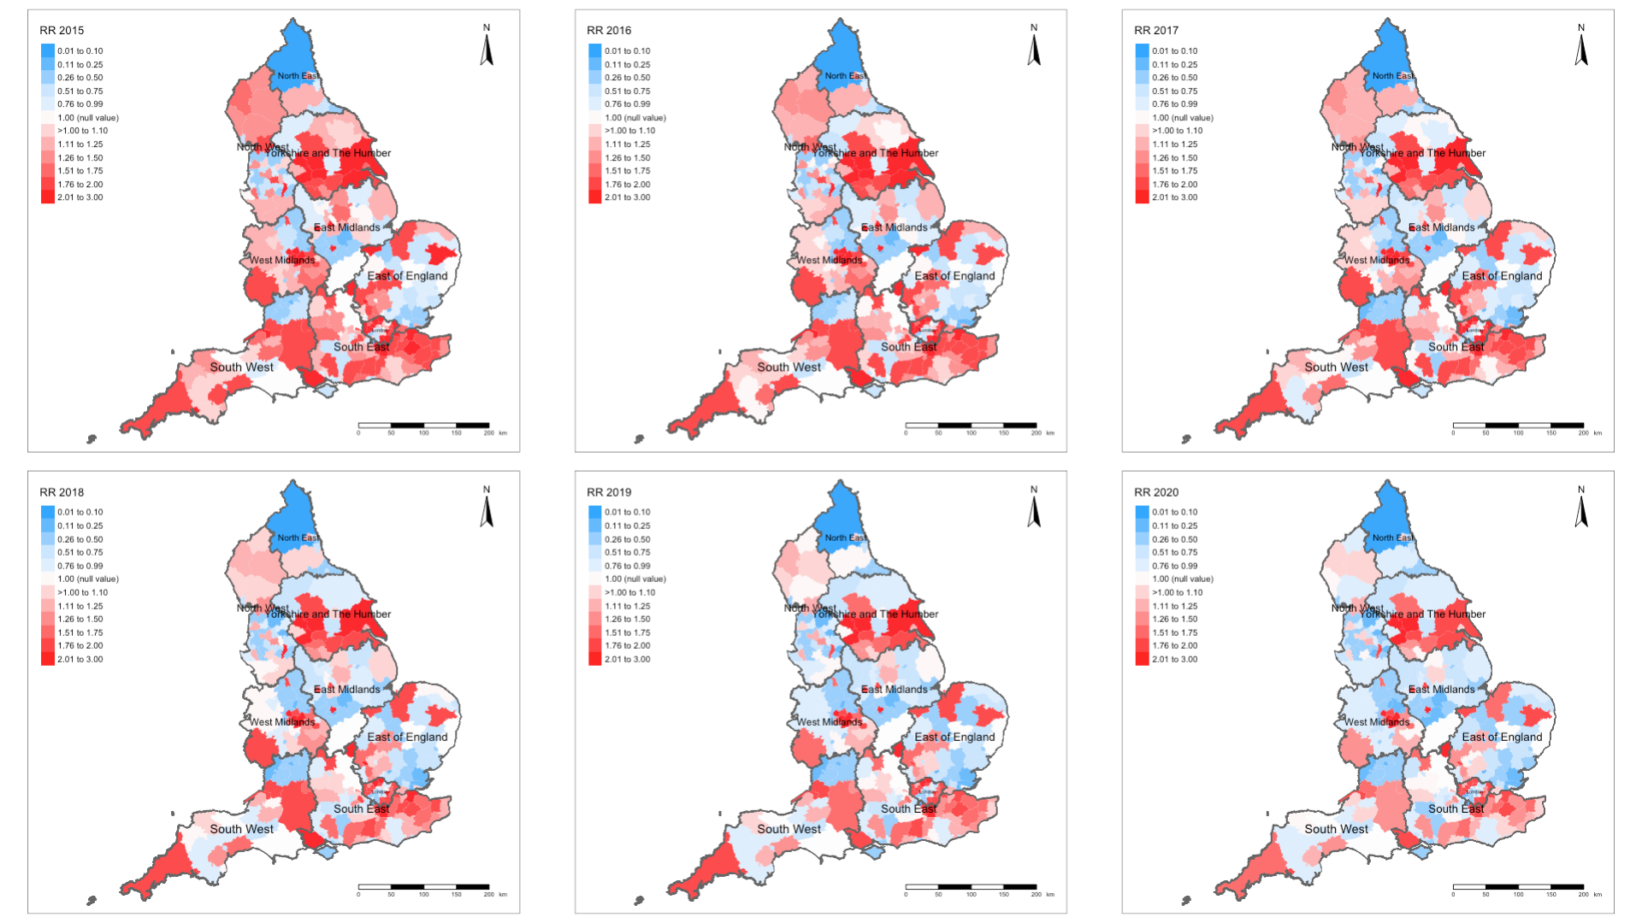
Example: Spatiotemporal Risks of Road-related casualties in England 2015-2020 [1]
Spatially and temporally varying relative risk estimates
29

Slide 30
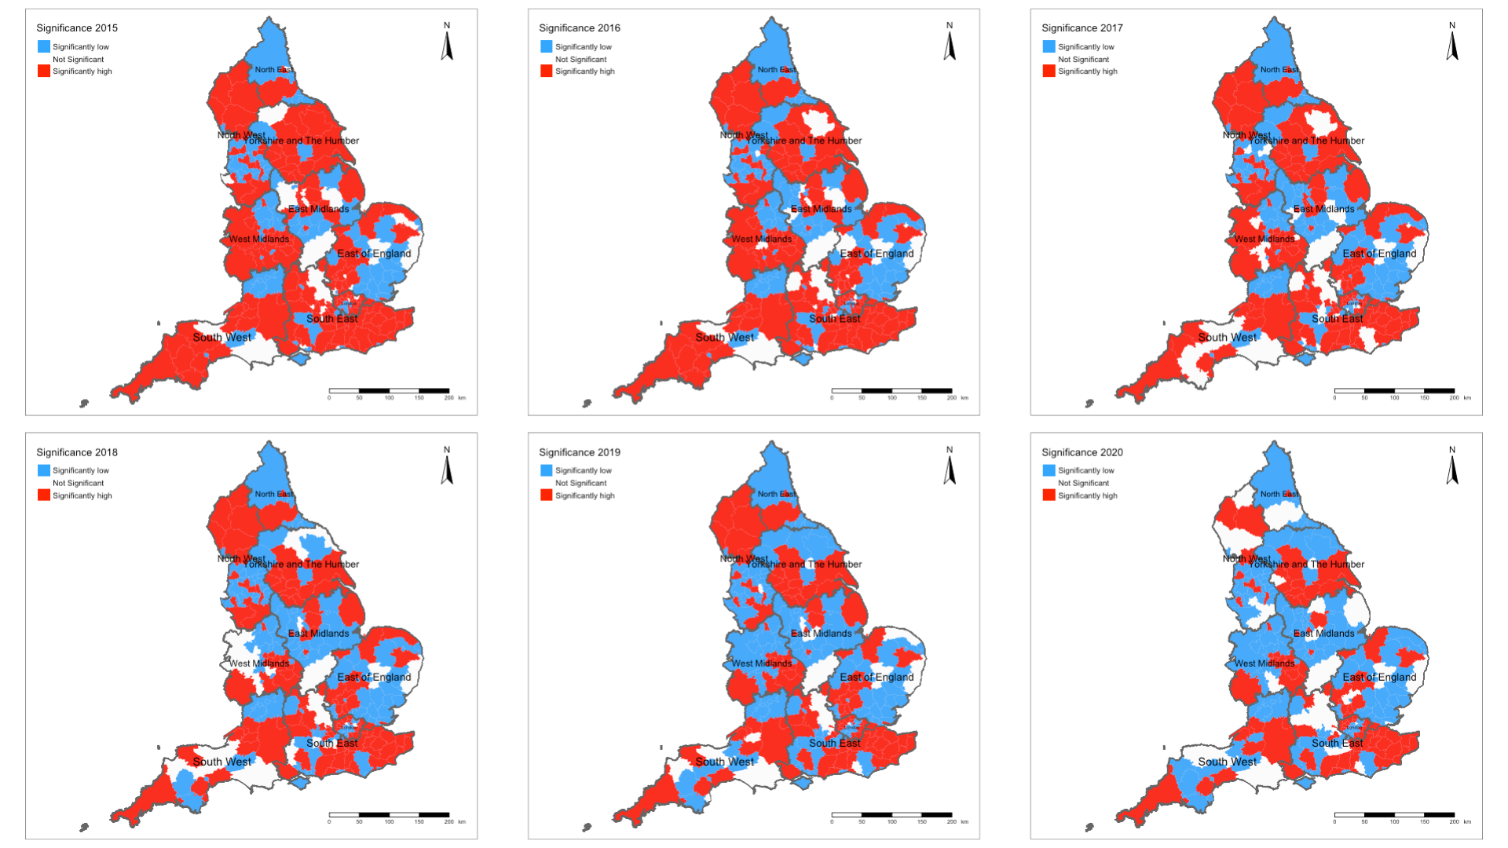
Example: Spatiotemporal Risks of Road-related casualties in England 2015-2020 [2]
Spatially and temporally varying significance categories
30

Slide 31
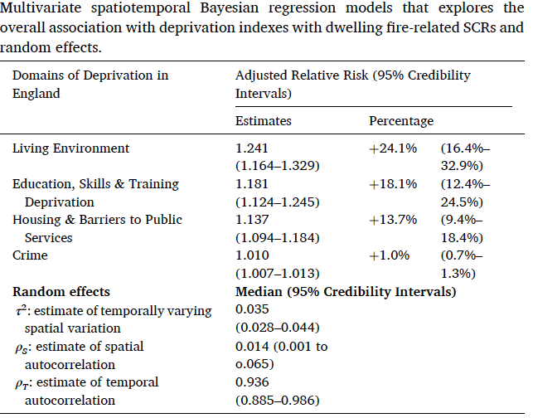
Table results illustrates the overall association between socioeconomic deprivation factors and risk of fire-related casualties in England (2010-19).
Interpretation:
Living environment: In the context of this socioeconomic deprivation domain – increased levels significantly increases the risk of fire-related casualties by 24.1% (1.241 times higher).
Barriers to housing and public service: In the context of this socioeconomic deprivation domain – increased levels significantly increases the risk of fire-related casualties by 13.7% (1.137 times higher).
Education, Skills & Training: In the context of this socioeconomic deprivation domain – increased levels significantly increases the risk of fire-related casualties by 18.1% (1.181 times higher).
Crime: In the context of this socioeconomic deprivation domain – increased levels marginally increases the risk of fire-related casualties by 1.0% (1.01 times higher). While this is statistically significant, the significance can be seen as something that is marginal.
NOTE: The random effects are reported in this instance to show the variation in risk. Most of it is captured in the time component (0.936 = 93.6%) meaning that there is a very strong temporal autocorrelation in the data.
Source: Li et al, (2022), Ecological study exploring the geospatial
associations between socioeconomic deprivation and
fire-related dwelling casualties in England (2010-2019),
DOI: https://doi.org/10.1016/j.apgeog.2022.102718
31

Slide 32
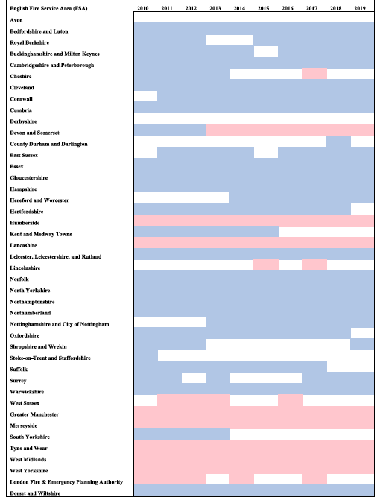
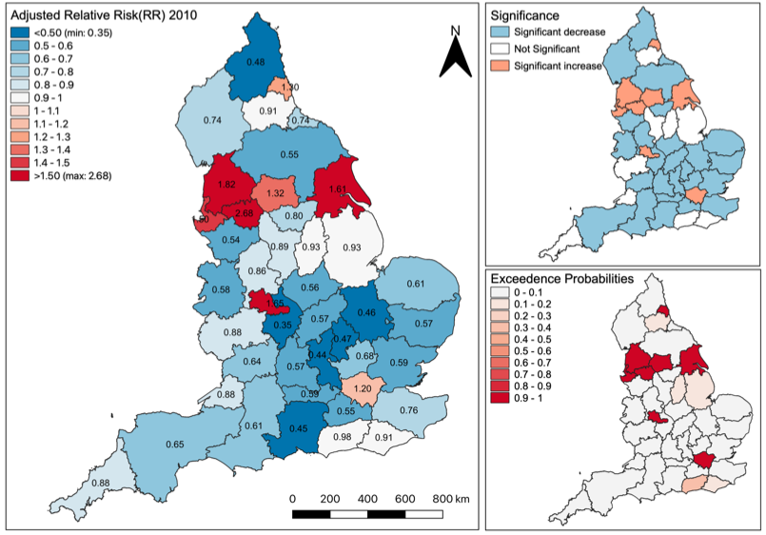
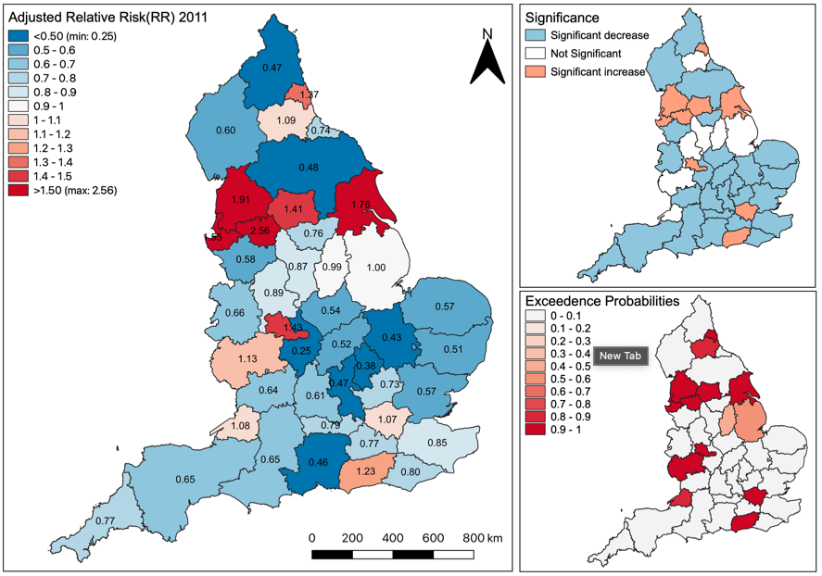
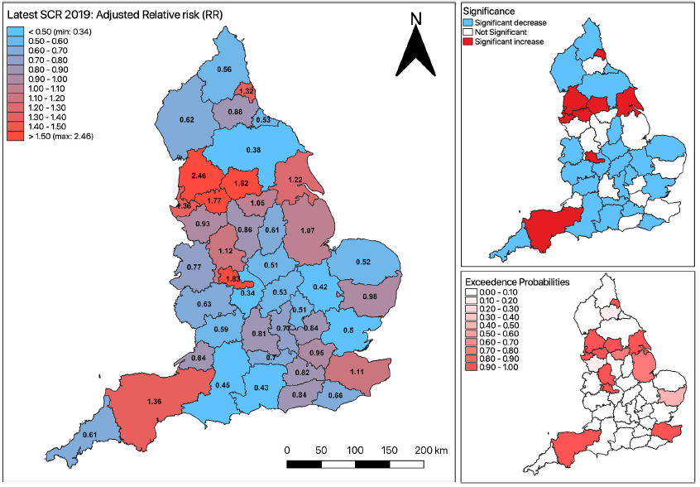



Spatial and temporal variation in risk of fire-related casualties
Translate maps to show significant risk trajectories
$$⋱$$
$$⋱$$
>>>
$$⋱$$
Interpretation: On a year-on-year basis, the increased risks are significantly sustained throughout the 10-year period for Humberside, Lancaster, Greater Manchester, Merseyside, Tyne and Wear, West Midlands, West Yorkshire, and Devon & Somerset.
Source: Li et al, (2022), Ecological study exploring the geospatial associations between socioeconomic deprivation and fire-related dwelling casualties in England (2010-2019). DOI: https://doi.org/10.1016/j.apgeog.2022.102718
32

Slide 33
GEOG0125: Course Evaluation & Student Feedback (Weeks 1-5)
https://forms.gle/TR23pj9rVmdsGACG8
Dear Students,
As part of the Continuous Module Dialogue, we are conducting this survey to gauge the levels of student satisfaction with the learning experience in module GEOG0125: Advanced Topics in Social & Geographic Data Science. We would like to receive your feedback, which would be greatly appreciated. This will help us make improvements to the course. The survey should only take up to 5-10 minutes, and your responses are completely anonymous.
Thank you,
Anwar and Stephen.
33

Slide 34
Any questions?
34

